Slide 1
Wigner-Eckart Theorem
Brian Nevins and Jordan Purcell

Slide 3
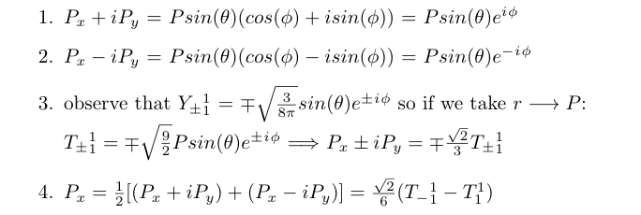
As an explicit example, let’s construct the explicit irreducible representation for the operator associated with momentum in the x-direction:

Slide 4
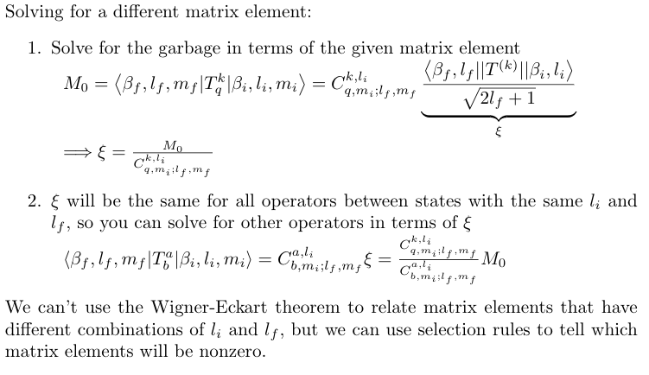
Subject exam questions have always been focused on selection rules, identifying which matrix elements are zero or nonzero, but we could also see questions like those we did in our quizzes: given one matrix element, find some others in terms of Clebsch-Gordon coefficients.

Slide 5
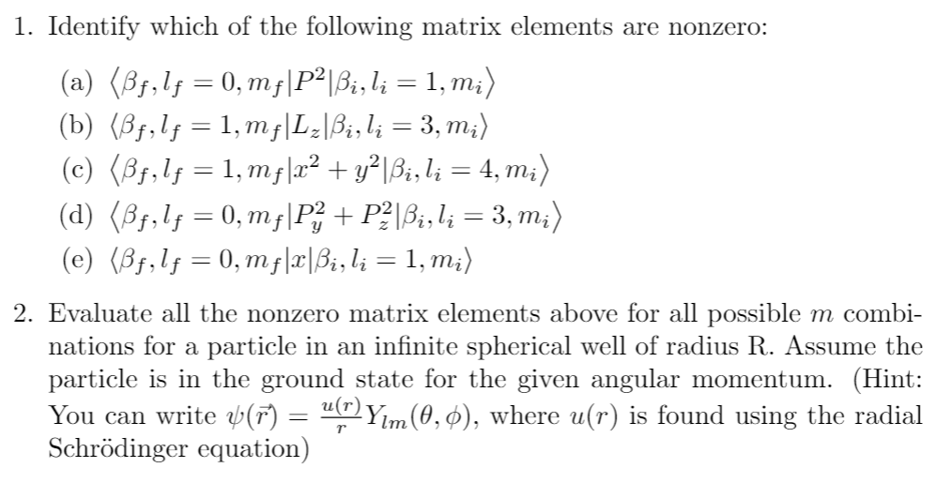

Slide 9
Step 1: Find the wave function (see section 4.10 of the notes)

Slide 10
Step 1: Find the wave function (see section 4.10 of the notes)

Slide 11
Step 2: Find a matrix element

Slide 12
Step 2: Find a matrix element

Slide 13
Step 3: Use Wigner-Eckart to get the matrix elements we want

Slide 14
Step 3: Use Wigner-Eckart to get the matrix elements we want

