Slide 1
3D-Movies
Todd Morra
Scott Borden
Erin Mccomb
Binocular depth perception
Experiencing 3D Movies
Filming 3D Movies

Slide 2
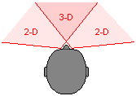
Binocular Depth-Perception
Two different perspectives
120° field of 3D view
Distance vs. Acuity
BD=κ_{F}-κ_{D}=θ_{r}-θ_{l}

Slide 3
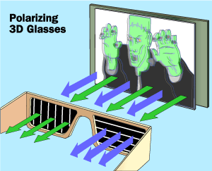
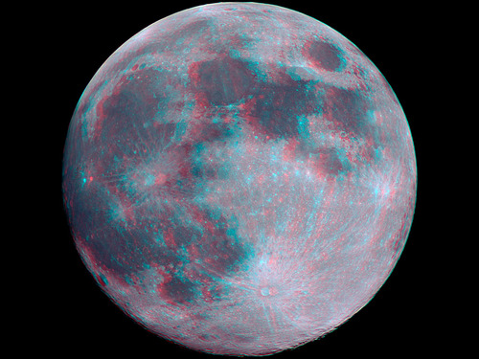
Types of 3D
Red/Blue
Polarization

Slide 4
Polarization Glasses
The two images are linearly polarized orthogonal to each other
The lens of the glasses have transmission axes orthogonal to each other
I(θ) = I₀ cos²(θ)
Through each lens, one image is polarized parallel to the transmission axis (θ = 0) so I(θ) = I₀
The other image is polarized perpendicular to the transmission axis (θ = π/2), so I(θ) = 0

Slide 5
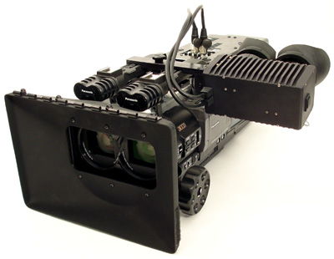
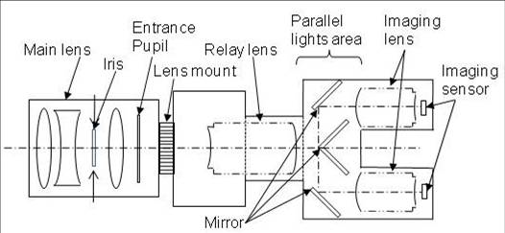
How to Film 3D Movies
Two cameras film the same scene from two slightly different locations.
One camera which uses mirrors in place of shutters so incoming light can be simultaneously separated into left and right images creating a natural and smooth image.

Slide 6
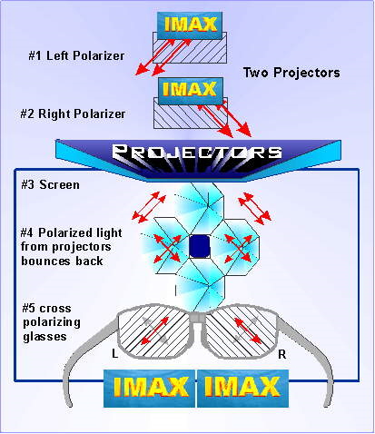
How to Project 3D Movies
RealD 3D uses a single high resolution digital projector and a silver screen to produce 3D images.
The projector displays 144 frames per second where each frame is projected 3 times per eye to reduce flickering problems.
Monitor ZScreen® 2000 Series circularly polarizes the left-eye and right-eye images in opposing directions.
The screen then maintains this circular polarization as the light passes through it.

Slide 7
References
http://anthro.palomar.edu/primate/prim_1.htm
http://www.mindspring.com/~dmerriman/Imaxwrk.htm
http://demonstrations.wolfram.com/BinocularDisparityVisualDepthPerception7/
http://www.unmuseum.org/stereosc.htm
http://www.lavideofilmmaker.com/3-d/how-3-d-movies-work.html
Hecht
http://www.mindspring.com/~dmerriman/Imaxwrk.htm

Slide 8
References
http://www.photoclubalpha.com/2009/10/01/sony-invent-3d-movie-hdtv-camera/
http://science.howstuffworks.com/3-d-glasses2.htm
http://www.diyaudioandvideo.com/TV/3D/Theater/
http://www.reald.com/Content/Pro-FAQ.aspx
http://www.tru3d.com/technology/3D_Ready_HDTV_Monitors_Projectors.php?file=How%20Real%20D%20z%20Zcreen%20Works
http://www.springerlink.com/content/l346237987656818/

