Slide 1
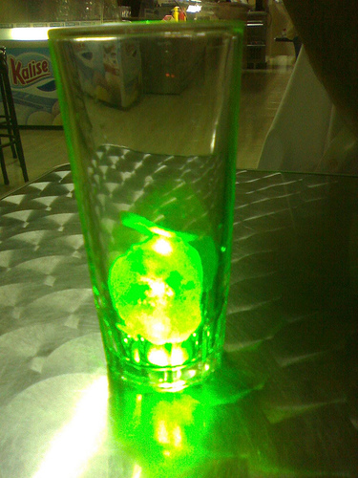
Laser Cooling and Trapping by Neil DeBoer and Clayton DeVault
For certain atoms lasers can used to reduce the overall kinetic energy for a portion of those atoms. By combining this with a magnet the atoms can be confined. These processes rely on use of the Doppler Effect and the Zeeman Effect.

Slide 2
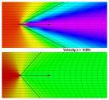
Laser Cooling: Background Information
Momentum and Energy of Photons
The Doppler Effect
From Quantum Theory a photon will carry a momentum of and an energy of .
Two observes moving relative to each other will observe the same wave with different frequency and wavelength.
The relativistic Doppler formula is given by,
Where v is the velocity of the observer, f_{o} is the frequency of the observer, and f_{s} is the frequency of the source.
Resonant Frequency of an Atom
Each atom has a set of resonant frequency.
The resonant frequency is given by ν_{o}.
An atom will absorb a photon only if the frequency of the photon matches the atoms resonant frequency.
When the atom absorbs the photon, it will go into an excited state.
At some random time later, the excited atom will return to its ground state with a spontaneous emission of a photon with energy hν_{o} in a random direction.

Slide 3
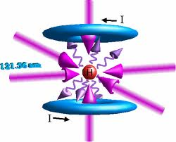
Laser Cooling: How it Works
The idea behind “cooling” a group of atoms is to decrease the overall kinetic energy of the system which will decrease the temperature due to the relation, TαE
A homogenous group of atoms is exposed to array of lasers each with a frequency slightly bellow the resonant frequency of the atoms.
An atom with velocity directed toward a laser source will encounter photons with an increased frequency due to the Doppler Effect.
These atoms will absorb these photons and go into an excited state and due to conservation of momentum, will slow down.
The atom will then emit a photon with energy f_{o} in a random direction and in the process looses kinetic energy.

Slide 4
Laser Cooling: Other Methods and Application
Doppler Cooling allows for temperatures down to the microKelvin level.
The limiting case of Doppler cooling is due to the fact that when the atom emits an absorbed photon it will always gain some momentum, thus we can never achieve absolute zero. The minimum temperature is given by
Doppler Cooling is not very affective for ions or larger atoms and molecules
To go beyond Doppler cooling additional methods are employed.
Two Examples
Applications
Atomic Clocks
Atom Interferometer
The focusing of atomic beams
Sisyphus Cooling
Using Doppler Cooling to reach low temperatures, a small amount of energy is removed each time an atom reaches it’s maximum potential energy.
Sympathetic Cooling
This method solves the problem of cooling large atoms and molecules or ions.
A group of atoms is cooled using the Doppler cooling and is brought in contact with a group of atoms needed to be cooled.
Due to the electromagnetic interaction between these two groups, the second group will decrease in temperature.

Slide 5
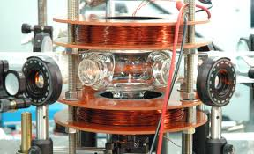
Magnetic Trapping
The Zeeman Effect
In a normal atom there can be electron states with the same energy.
In the presence of a magnetic field, the energies of the state will split into separate energies.
Megneto-Optical Trap (MOT)
A common type of magnetic trapping for Doppler Cooling is the Magneto-optical Trap (MOT)
By designing the magnetic fields and lasers cleverly, when an atom moves away from the center it will experience the Zeeman Effect and the change of the energy of the electron states will cause it to be more likely for the atoms to interact with the photon from the laser.
This causes the atoms to be be pushed toward the center of the device which essentially traps the atoms.

Slide 6
References
Hecht, Eugene, Optics, Fourth Edition, Pearson Education, Inc. San Fransisco, CA Copyright 2002
Saijun Wu, Thomas Plisson, Roger C. Brown, William D. Phillips, and J. V. Porto, Multiphoton Magnetooptical Trap, 2009, PHYSICAL REVIEW LETTERS, PRL 103, 173003
William D. Phillips, Laser Cooling and Trapping of Neutral Atoms, Nobel Lecture, December 8, 1997, National Institute of Standards and Technology, http://nobelprize.org/nobel_prizes/physics/laureates/1997/phillips-lecture.pdf.
Matthieu Vangeleyn, Paul F. Griffin, Erling Riis, and Aidan S. Arnold, Laser cooling with a single laser beam and a planar diffractor, October 15, 2010 / Vol. 35, No. 20 / OPTICS LETTERS 3453
Pictures
Slide one picture: http://www.flickr.com/photos/rvr/518803544/
Slide two picture: http://en.wikipedia.org/wiki/Relativistic_Doppler_effect
Slide three picture: http://www.mpq.mpg.de/~haensch/antihydrogen/spectroscopy.html
Slide four: http://fr.toonpool.com/cartoons/Sisyphus_11579
Slide five: http://commons.bcit.ca/physics/jbooth/motlab/mot_atomtraps.htm

