Slide 1
CMX: tasks and schedule
Wojtek Fedorko for the MSU group

Slide 2
CMX development schedule as shown before (still valid)
2011: Project and engineering specifications
CMX project Preliminary Design Review (Done)
Preliminary design studies (Ongoing)
Test rig installed, checked out at MSU (postponed until 2012)
2012: Prototype design and fabrication
CMX schematics and PCB layout (ongoing)
CMM firmware ported on CMX
Prototype fabrication (fall 2012)
Basic tests for backward compatibility in test rig at MSU
Production Readiness Review
2013: Prototype testing/installation/commissioning, final fabrication
Full prototype tests in test rig at CERN
CMX firmware development and test
Test in the L1Calo system during shutdown
Fabricate and assemble full set of CMX modules
2014: Final commissioning in the L1Calo trigger system in USA15
Notes:
1

Slide 3
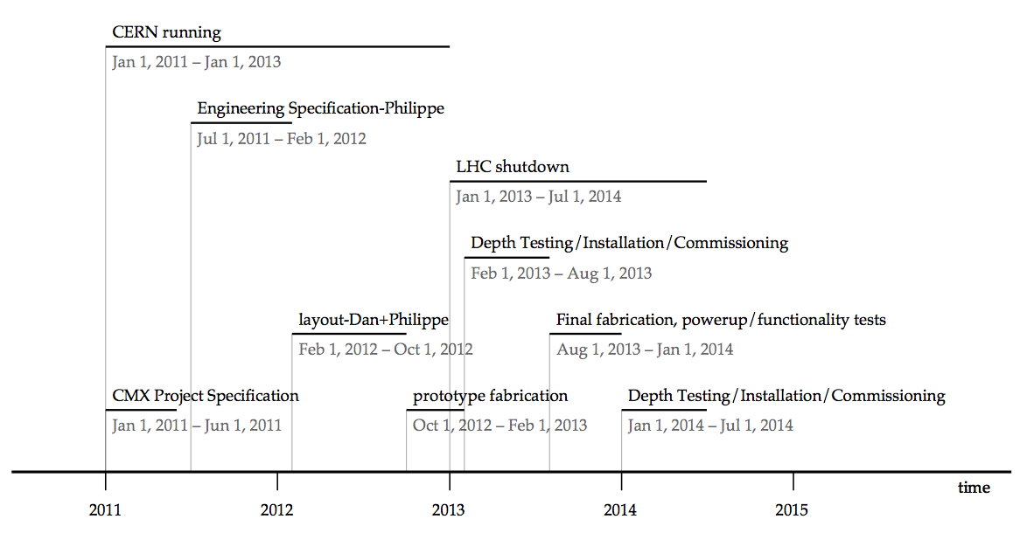
CMX development timeline: Yuri’s/Dan’s slide from mini-TDAQ
Notes:
2

Slide 4
Hardware milestones
Preliminary Design Review (PDR): - Stockholm
Final Design Review (FDR)
Not included in the scheduled discussed previously
Required procedure?
If required best option would be to have FDR after design sent for fabrication
prototype: 2013.01.31
Production Readiness Review (PRR):
After prototype received and tested
production: ~fall 2013
installation: ~spring 2014

Slide 5
Firmware development planning

Slide 6
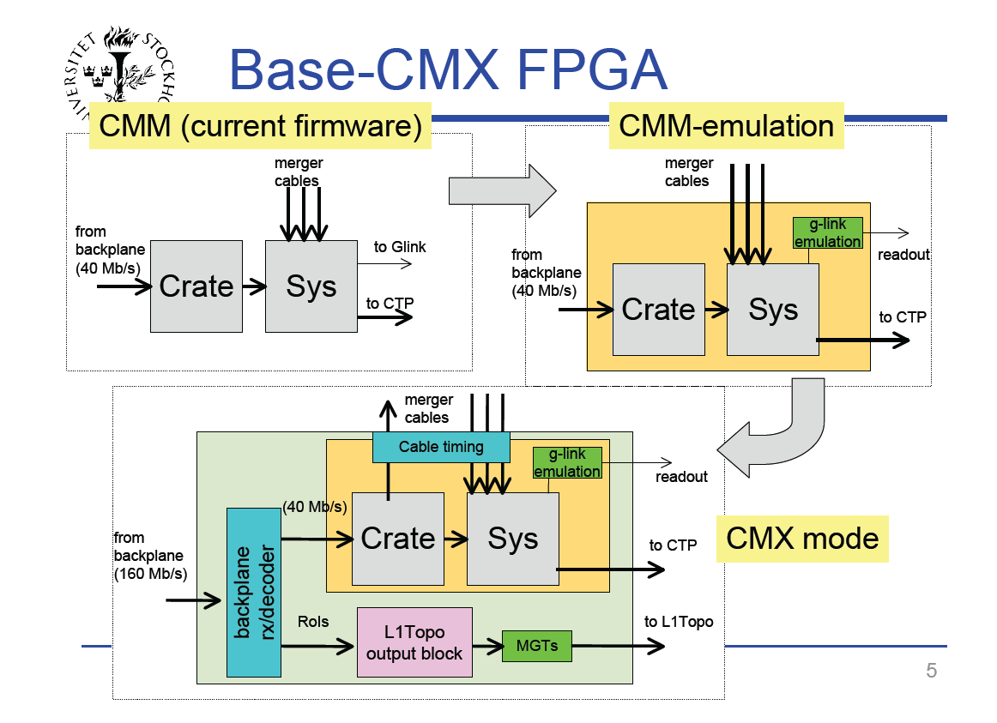
Slide from Sam’s May 24th talk
“MSU will develop format-independent
boundaries to the FPGAs on the CMX,
and coordinate subsystem-specific code development with other institutes."

Slide 7
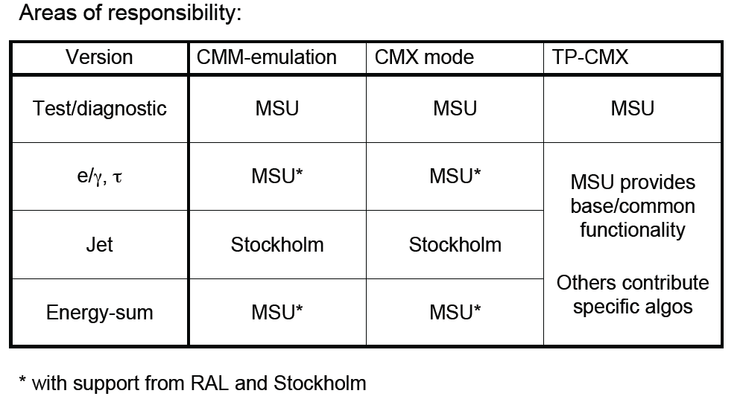
Base CMX Firmware versions: from Sam’s May 24th talk
*
*
*
*
* continued development by Wojtek at UBC
* no firm commitment from MSU (except for coordination)

Slide 8
Base CMX Firmware – filling in the boxes (system)
LVDS @160Mbps
VME config/control
LVDS RX
readout
glink emulator
CMM emulator
To CTP LVDS @40Mbps
Crate
System
LVDS TX
16x96x40Mbps
Backplane 16x24x160Mbps
Input module
To L1Topo
6.4Gbps
decoder
L1 Topo output block
MGT TX
Legend:
Common to all flavors
Flavor specific

Slide 9
Base CMX Firmware – filling in the boxes (crate)
LVDS @160Mbps
VME config/control
LVDS TX
readout
glink emulator
CMM emulator
To CTP LVDS @40Mbps
Crate
System
LVDS TX
16x96x40Mbps
Backplane 16x24x160Mbps
Input module
To L1Topo
6.4Gbps
decoder
L1 Topo output block
MGT TX
Legend:
Common to all flavors
Flavor specific

Slide 10
Input Module
Was needed urgently to guide layout
Implemented with the clk/parity encoding scheme
Will be tested in eval kit
First implementation with 80 MHz DDR scheme
Needs verification and eval kit test
In both cases ‘toy’ interface
Full projected functionality
e.g. IDELAY, IDDR
details of how this would be configured will change
Capture data into registers and ‘deserialization’ into 96 bit word
No synchronization between channels
Parity calculation and error flag

Slide 11
Other Firmware Modules
Need to define functionality and interfaces between firmware ‘modules’
Resource sharing (e.g. MMCM – clock generation and buffering)
‘Take out’ some functionality from the CMM emulator module
Start work from the ‘Jet’ version of CMX
Expect that common module interfaces will work for other versions
Manpower (Pawel) available to work on this version outside of MSU
Experience with CMM
Will be able to use this or stripped down version of this firmware for board tests
Need complete firmware before prototype arrives early next year. Hope ready sooner.
Part of firmware testable in Yuri’s TTC/VME/ACE test card.
Expect duty cycle between Pawel and myself to decrease in the coming weeks.
Other firmware versions will follow after prototype tests.

Slide 12
Questions that need clarification to guide the firmware design
80MHz DDR on bit 24 decided?
Do we have an agreement on data formats for all flavors?
Circulation of documentation?
Location of parity bit
Constant in the payload between the flavors?
Synchronization of processor inputs
At which stage this needs to happen? Input module?
Efficient use of the data format
What data can be made available early to minimize latency?
Behavior on error?
Include information in the real time data?
Special L1A to force readout?
…

Slide 13
CMX Topo FPGA
Plans for firmware development need to be discussed
Hope for common firmware architecture with L1Topo
Test version needs to be ready for prototype testing.
Link tests

Slide 14
Software development (Seth Caughron)
Goals:
Ability to test the VME/TTC/ACE test card and CMX within L1Calo software framework
Develop expertise now using the 6U crate in bldg. 32 and Yuri’s test card
When prototype arrives we must be ready to test it.
Status:
We need and are getting help
Murrough and Seth have cloned the software objects modeling the CMM into CMX
Assumes CMX register model will be an evolution of the CMM
Working on setting up a small partition in the 6U crate
Will be ‘playing’ with Yuri’s card on completion of the inspection and smoke test (mid August)

Slide 15
Conclusions
Hardware schedule well defined
Procedural question about FDR
Base CMX firmware goals set
Most urgent tasks guiding hardware design complete
Need finer planning of further development and more intermediate goals
TP-CMX firmware needs more thinking
Software work just starting
Discussion in this forum very welcome
We are grateful for the expertise provided so far (and we’ll need more)

