Slide 1
CMX
Collection file for current diagrams
30-Apr-2014

Slide 2
CMX Card with Base-CMX functionality only
Optical output
From Base Function
To L1Topo
and/or CMX-Topo
(up to 24x @ 6.4 Gbps)
MPT
2x 12-fiber
ribbons OUT
Board Support FPGA
VME - - Bus Transceivers
VME --
MPT
12x Optic OUT
Optical output
DAQ &ROI readout
From Base Function
(2x G-Link or S-Link)
SFP
ROI
12x Optic OUT
Base
Function
FPGA
Virtex-6
LX550T-FF1759
Inputs from
All 16x JEM
or 14x CPM
Processors
From this crate
SFP
DAQ
CTP output
From Base Function
(up to 2x
33x LVDS pairs
@ up to 160 Mbps)
(400x single ended
2.5V CMOS signals
@ 160 Mbps)
LVDS Transceivers
M U X
Topo
Function FPGA
Virtex-6
LX550T-FF1759
LVDS cables
From Crate CMX
To System CMX
SFP
ROI
12x Optic IN
LVDS Transceivers
SFP
DAQ
12x Optic IN
(up to 3x
27x LVDS pairs
@ up to 160 Mbps)
Compact
Flash Card
12x Optic IN
TCM
System
ACE
Clock Generator
TTC Receiver
Test Connector:
JTAG, CAN bus
& Access Signals
CAN Bus
Monitoring
Temp, V & I
CAN Bus
30-Apr-2014

Slide 3
CMX Card with Base-CMX functionality and TP-CMX capability
Optical output
From Base Function
To L1Topo
and/or CMX-Topo
(up to 24x @ 6.4 Gbps)
MPT
2x 12-fiber
ribbons OUT
Board Support FPGA
VME - - Bus Transceivers
VME --
Optical input
From up to 12 CMXs
To CMX-Topo
(up to 36x @ 6.4 Gbps)
MPT
3x 12-fiber
ribbons IN
12x Optic OUT
Optical output
DAQ &ROI readout
From Base Function
(2x G-Link or S-Link)
SFP
ROI
12x Optic OUT
Base
Function
FPGA
Virtex-6
LX550T-FF1759
Inputs from
All 16x JEM
or 14x CPM
Processors
From this crate
SFP
DAQ
CTP output
From Topo Function
(up to 2x
33x LVDS pairs
@ up to 160 Mbps)
(400x single ended
2.5V CMOS signals
@ 160 Mbps)
LVDS Transceivers
M U X
Topo
Function FPGA
Virtex-6
LX550T-FF1759
LVDS cables
From Crate CMX
To System CMX
Optical output
DAQ &ROI readout
From Topo Function
(2x G-Link or S-Link)
SFP
ROI
12x Optic IN
LVDS Transceivers
SFP
DAQ
12x Optic IN
(up to 3x
27x LVDS pairs
@ up to 160 Mbps)
Compact
Flash Card
12x Optic IN
TCM
System
ACE
Clock Generator
TTC Receiver
Test Connector:
JTAG, CAN bus
& Access Signals
CAN Bus
Monitoring
Temp, V & I
CAN Bus
30-Apr-2014

Slide 4
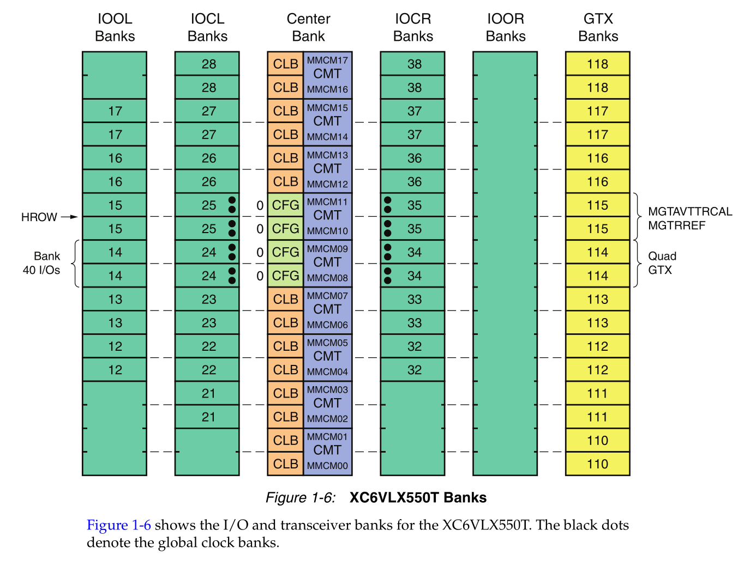
IO Banks available on Virtex6 LX550T

Slide 5
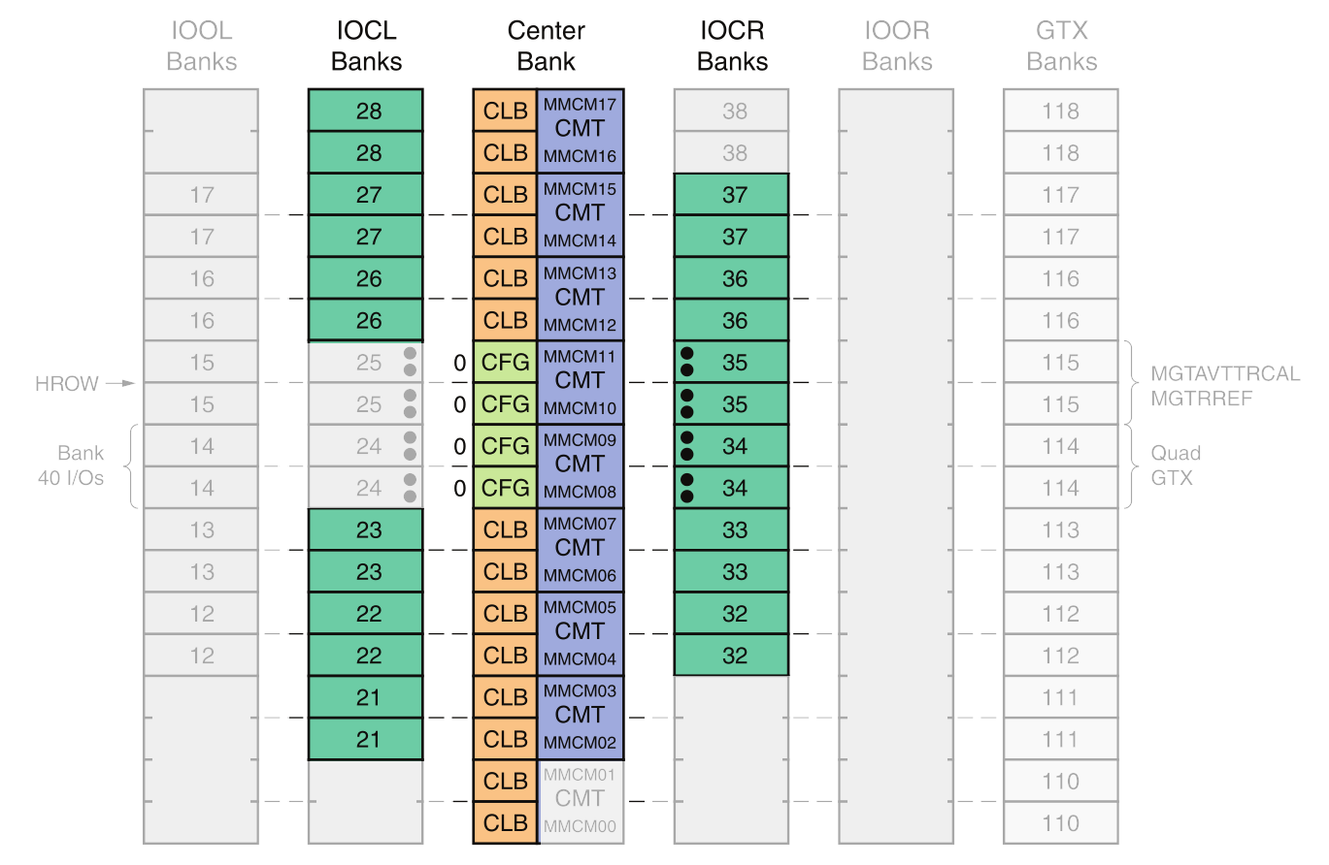
CMX IO Bank Assignment for Processor Inputs (using only Inner Columns and exactly two Regional Clocks per Horizontal Row)
P04
P05
2
1
1
P03
P02
P06
P07
1
1
P01
P00
2
2
P15
P14
P08
P09
1
1
P13
P12
1
1
P10
P11
2
Number of
Regional Clocks
used per IO Bank
(2 per row →match for MMCM)

Slide 6
CMX emulation of CMM functionality (no TP involved)
Energy
Jet
Electron
Tau
CMX
Base
FPGA
CMX
Base
FPGA
CMX
Base
FPGA
CMX
Base
FPGA
CMX
Base
FPGA
CMX
Base
FPGA
CMX
Base
FPGA
CMX
Base
FPGA
Crate
CMXs
- - - - - - - -
LVDS
Cables
LVDS
Cables
LVDS
Cables
LVDS
Cables
System
CMXs
CMX
Base
FPGA
CMX
Base
FPGA
CMX
Base
FPGA
CMX
Base
FPGA
to CTP
to CTP
to CTP
to CTP

Slide 7
L1topo receives Zero-Suppressed data from all CMXs
Energy
Jet
Electron
Tau
Crate
CMX
Crate
CMX
Crate
CMX
Crate
CMX
Crate
CMX
Crate
CMX
Crate
CMX
Crate
CMX
CMX
Base
FPGA
CMX
Base
FPGA
CMX
Base
FPGA
CMX
Base
FPGA
CMX
Base
FPGA
CMX
Base
FPGA
CMX
Base
FPGA
CMX
Base
FPGA
Crate
CMXs
- - - - - - - -
LVDS
Cables
2x12
LVDS
Cables
LVDS
Cables
LVDS
Cables
System
CMXs
System
CMX
System
CMX
System
CMX
System
CMX
2x 12-fiber ribbon
CMX
Base
FPGA
CMX
Base
FPGA
CMX
Base
FPGA
CMX
Base
FPGA
to CTP
to CTP
to CTP
to CTP
Up to 24x 12-fiber ribbons
Optical
Patch
Panel
L1Topo
N x 12
to CTP

Slide 8
Older CMX Diagrams
Historical repository
Some still valid or may need editing

Slide 9
2. Standalone TP receiving Raw CMX Inputs
Energy
Jet
Electron
Tau
Base-
CMX
FPGA
Base-
CMX
FPGA
Base-
CMX
FPGA
Base-
CMX
FPGA
Base-
CMX
FPGA
Base-
CMX
FPGA
Base-
CMX
FPGA
Base-
CMX
FPGA
Crate
CMXs
- - - - - - - -
LVDS
Cables
12
LVDS
Cables
LVDS
Cables
LVDS
Cables
System
CMXs
1 x 12-fiber ribbon
Base-
CMX
FPGA
Base-
CMX
FPGA
Base-
CMX
FPGA
Base-
CMX
FPGA
to CTP
to CTP
to CTP
to CTP
12 x 12-fiber ribbons
Standalone
Topological
Processor
to CTP

Slide 10
4. One (or more) CMX TP receiving Zero-Suppressed Inputs
Energy
Jet
Electron
Tau
to CTP
to CTP
TP-
CMX
FPGA
TP-
CMX
FPGA
Base-
CMX
FPGA
Base-
CMX
FPGA
Base-
CMX
FPGA
Base-
CMX
FPGA
Base-
CMX
FPGA
Base-
CMX
FPGA
Base-
CMX
FPGA
Base-
CMX
FPGA
Crate
CMXs
- - - - - - - -
LVDS
Cables
12
LVDS
Cables
LVDS
Cables
LVDS
Cables
System
CMXs
1 x 12-fiber ribbon
3 x 12-fiber
Base-
CMX
FPGA
Base-
CMX
FPGA
Base-
CMX
FPGA
Base-
CMX
FPGA
Optical
Patch
Panel
to CTP
to CTP
to CTP
to CTP
12 x 12 fiber ribbons

Slide 11
5. CMX TP & Standalone TP receiving Zero-Suppressed Inputs
Energy
Jet
Electron
Tau
to CTP
TP-
CMX
FPGA
Base-
CMX
FPGA
Base-
CMX
FPGA
Base-
CMX
FPGA
Base-
CMX
FPGA
Base-
CMX
FPGA
Base-
CMX
FPGA
Base-
CMX
FPGA
Base-
CMX
FPGA
Crate
CMXs
- - - - - - - -
LVDS
Cables
24
LVDS
Cables
LVDS
Cables
LVDS
Cables
System
CMXs
2 x 12-fiber ribbon
3 x 12-fiber
Base-
CMX
FPGA
Base-
CMX
FPGA
Base-
CMX
FPGA
Base-
CMX
FPGA
Optical
Patch
Panel
to CTP
to CTP
to CTP
to CTP
up to 24 x 12-fiber ribbons
Standalone
Topological
Processor
to CTP
N x 12-fiber ribbons

Slide 12
6. CMX TP receiving Zero-Suppressed & Standalone TP raw inputs
Energy
Jet
Electron
Tau
to CTP
TP-
CMX
FPGA
Base-
CMX
FPGA
Base-
CMX
FPGA
Base-
CMX
FPGA
Base-
CMX
FPGA
Base-
CMX
FPGA
Base-
CMX
FPGA
Base-
CMX
FPGA
Base-
CMX
FPGA
Crate
CMXs
- - - - - - - -
LVDS
Cables
24
LVDS
Cables
LVDS
Cables
LVDS
Cables
System
CMXs
2 x 12-fiber ribbon
3 x 12-fiber
Base-
CMX
FPGA
Base-
CMX
FPGA
Base-
CMX
FPGA
Base-
CMX
FPGA
Optical
Patch
Panel
to CTP
to CTP
to CTP
to CTP
to CTP
12 x 12-fiber ribbons
Standalone
Topological
Processor
12 x 12-fiber ribbons

Slide 13
7. Example of TP-CMX FPGA in Crate to System communication
Energy
Jet
Electron
Tau
Base-
CMX
FPGA
Base-
CMX
FPGA
Base-
CMX
FPGA
Base-
CMX
FPGA
Base-
CMX
FPGA
Base-
CMX
FPGA
Base-
CMX
FPGA
Base-
CMX
FPGA
Crate
CMXs
- - - - - - - -
LVDS
Cables
LVDS
Cables
LVDS
Cables
to CTP
1 x 12-fiber ribbon
System
CMXs
TP-
CMX
FPGA
3 x 12 fibers
Base-
CMX
FPGA
Base-
CMX
FPGA
Base-
CMX
FPGA
Base-
CMX
FPGA
Optical
Patch
Panel
to CTP
to CTP
to CTP
4 x 12 fiber ribbons

