Slide 1
Status and planning of the CMX
Philippe Laurens for the MSU group
Level-1 Calorimeter Trigger General Meeting, CERN
May 24, 2012

Slide 2
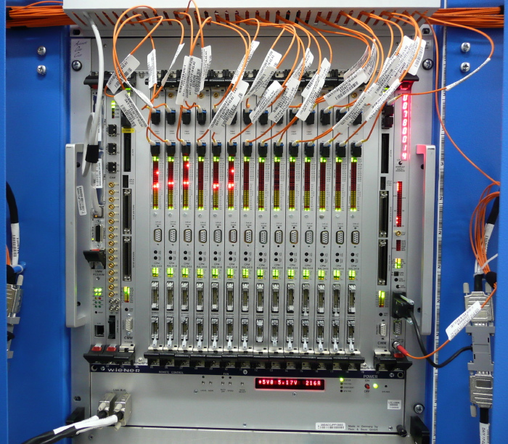
CMX: CMM upgrade
CMX replaces CMM:
JEM/CPM to CMX (backpl) rate 40 →160Mbps
Crate CMX to System CMX (cables) rate 40 →160Mbps
Cluster information sent to Topological Processor (12-fiber ribbons @6.4Gbps)
Optional partial TP capability included
Standalone TP is now planned
Some TP capability still desired for CMX platform (flexibility)

Slide 3
The CMX overview
ROI
VME--
VME-- Interface
2x G-Link Out
DAQ
TCM
TCM Interface
12x Optic IN
3x 12-fiber
ribbons IN
6.4 Gbps inputs
re-bundled from
up to 12 Base-CMX
TP-CMX FPGA
Virtex-6
LX550T-FF1759
12x Optic IN
Inputs from all
JEM or CPM
processors
from this crate
12x Optic IN
CTP output
2x33 LVDS pairs
@ 40 Mbps
(from TP-CMX
via Base-CMX)
400 single ended
@ 160Mbps
Base-CMX FPGA
Virtex-6
LX550T-FF1759
12x Optic OUT
6.4 Gbps outputs
to Standalone TP
and/or TP-CMX
LVDS cables
From Crate
To System CMX
2x 12-fiber
ribbons OUT
12x Optic OUT
ROI
3x27 LVDS pairs
@ up to 160 Mbps
2x G-Link Out
DAQ

Slide 4
CMX: modular design, most cards assembled without TP functionality
VME--
VME-- Interface
TCM
TCM Interface
Inputs from all
JEM or CPM
processors
from this crate
CTP output
2x33 LVDS pairs
@ 40 Mbps
(System CMX
only)
400 single ended
@ 160Mbps
Base-CMX FPGA
Virtex-6
LX550T-FF1759
12x Optic OUT
6.4 Gbps outputs
to Standalone TP
and/or TP-CMX
LVDS cables
From Crate
To System CMX
2x 12-fiber
ribbons OUT
12x Optic OUT
ROI
3x27 LVDS pairs
@ up to 160 Mbps
2x G-Link Out
DAQ

Slide 5
CMX: Use scenario with standalone TP
Energy
Jet
Electron
Tau
Base-
CMX
FPGA
Base-
CMX
FPGA
Base-
CMX
FPGA
Base-
CMX
FPGA
Base-
CMX
FPGA
Base-
CMX
FPGA
Base-
CMX
FPGA
Base-
CMX
FPGA
Crate
CMXs
- - - - - - - -
LVDS
Cables
12
LVDS
Cables
LVDS
Cables
LVDS
Cables
System
CMXs
1 x 12-fiber ribbon
Base-
CMX
FPGA
Base-
CMX
FPGA
Base-
CMX
FPGA
Base-
CMX
FPGA
to CTP
to CTP
to CTP
to CTP
12 x 12-fiber ribbons
Optical
Patch
Panel
Standalone
Topological
Processor
N x 12
to CTP

Slide 6
CMX development work on 3 fronts
3 parallel efforts
CMX Engineering @MSU
Philippe, Dan, and Chip
CMX input module firmware @CERN
Wojtek and Yuri
VME/ACE/TTC (VAT) interface @CERN
Yuri
CMX development schedule from Stockholm Preliminary Design Review is still valid
Minor adjustments
Notes:
5

Slide 7
CMX development schedule from PDR
2011: Project and engineering specifications
CMX project Preliminary Design Review (done)
Preliminary engineering design studies (done, RAL review)
Test rig installed, checked out at MSU (postponed until 2012)
2012: Prototype design and fabrication
CMX schematics and PCB layout (ongoing)
CMM firmware ported to CMX
Prototype fabrication (fall 2012)
Basic tests for backward compatibility in test rig at MSU
Production Readiness Review
2013: Prototype testing/installation/commissioning, final CMX fabrication
Full prototype tests in test rig at CERN
CMX firmware development and test
Test in the L1Calo system during shutdown
Fabricate and assemble full set of Final CMX (bulk with just Base, few with TP)
2014: Final commissioning in the L1Calo trigger system in USA15
Notes:
6

Slide 8
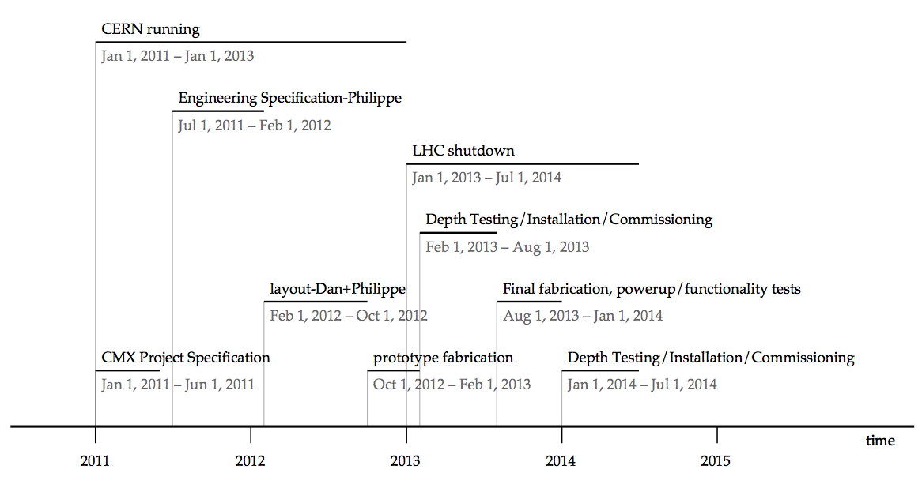
CMX development timeline

Slide 9
2012
2012: Prototype design and fabrication
CMX schematics and PCB layout
CMX technology choice with Dual FPGA design: Base-CMX & TP-CMX (RAL Feb 2012)
6U VME test card for VAT interface (PCB ready for testing in June)
Real-time data path layout (ongoing)
CMX input module firmware currently under test on the XILINX development module
Power budget estimate
Prototype fabrication
mechanical testing
Blank card, backplane connectors, front panel tests.
Will happen before real prototype board, but not urgent yet.
CMM firmware ported on CMX
Firmware for VAT interface (2 CPLD + TTC FPGA) to Spartan-3AN FPGA (Adapt VHDL code, create test bench, specify VME register model) (Yuri)
Most of CMM data path work completed at Stockholm (Pawel Plucinski, Sam Silverstein)
Needs to be adapted to final package choice
Basic tests for backward compatibility in test rig at MSU
Production Readiness Review (L1Calo/TDAQ) Fall/Winter
PRR after the prototype(s) is tested and
final check before going into full production of final modules
Notes:
8

Slide 10
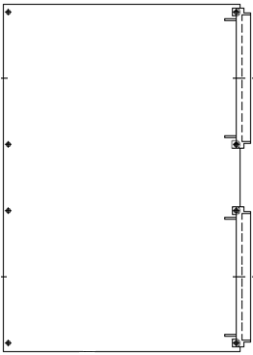
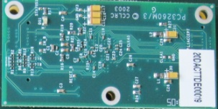
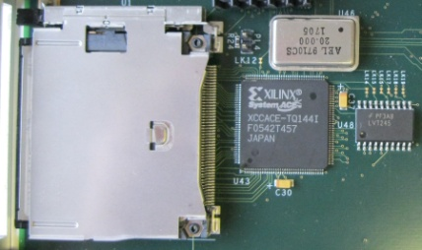
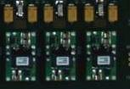
2012: PCB layout: VME/ACE/TTC (VAT) interface test card
VME CPLD
TTCrx
TTC FPGA
TTCDec
FC
TTC
SystemACE
ACE CPLD
VME/ACE/TTC (VAT) part of CMM
Redesign HW with new components
Fit design into single device
6U VME test card for
Hardware implementation
Main FPGA re-configuration
Software
To be merged into CMX design
PCB arrives in June
Next:
Firmware for VAT card
Firmware for Virtex 6 FPGA
Test Stand and software
Spartan-3AN
VME-- logic
5V0
JTAG
1V2
3V3
2V5
CF
Virtex6
1V0
SystemACE
1V0
2V5
3V3
Connector for CANbus i/f
Power

Slide 11
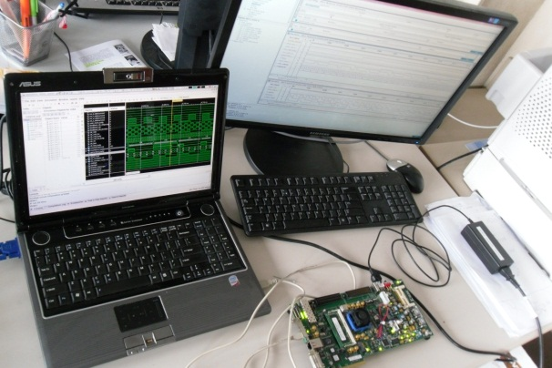
2011/2012: design studies: Clock/parity recovery
Clock+Parity encoded on single line
Variable duty cycle
Setup:
Scheme tested using Virtex 6 eval board
Data capture developed, simulated and ‘Placed and Routed’ on target FPGA
Needs repeating – different package chosen
BUFR
Clock/parity
40 MHz
96 bits @ 40MHz
MMCM
Regional clock buffer (BUFR)
BUFIO
40MHz register
x 16
80 MHz
IDDR
Data

Slide 12
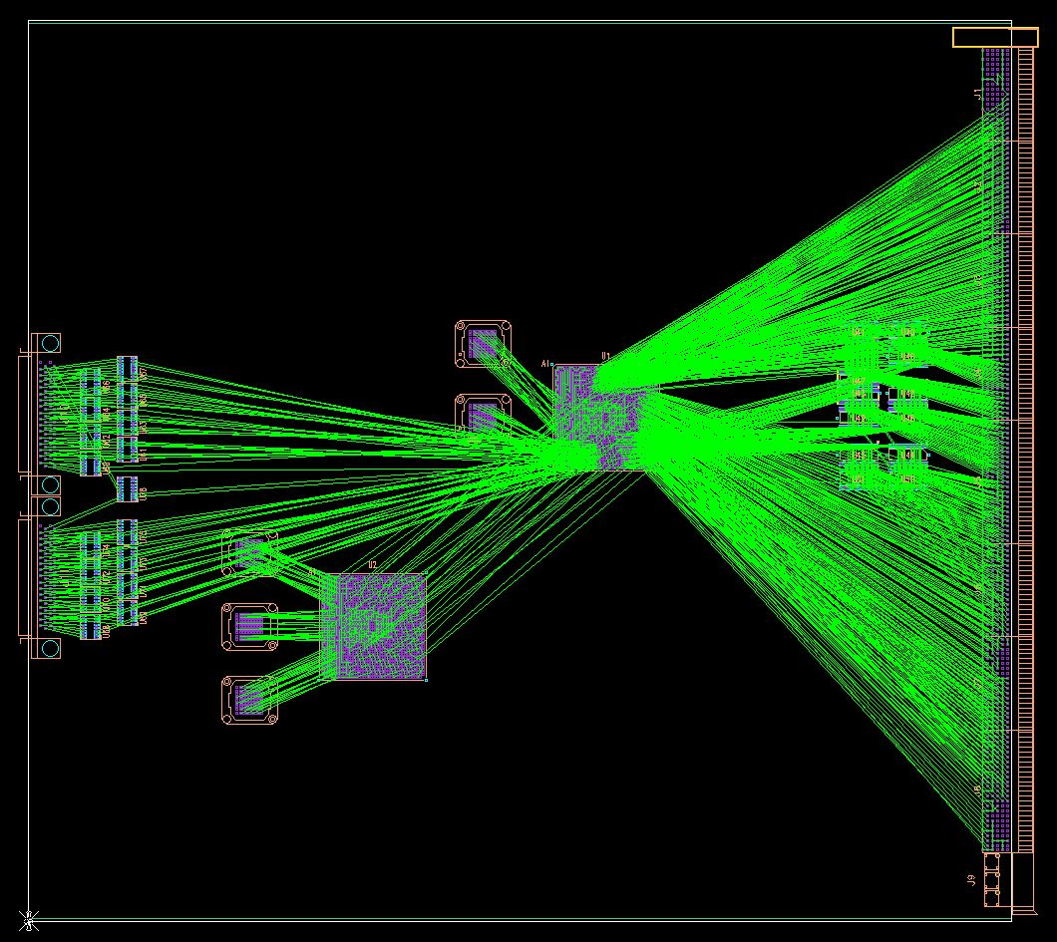
2012 PCB Layout: Backplane – FPGA connection
Optimize Real-Time Path Layout
High local density near FPGA
Especially 400x JEM/CPM inputs
Spread out & mixed up on backpln → grouped & sorted at FPGA
Span neighbor IO blocks
Regional Clock input for clock/parity
Tune IO Assignments
Cleanest connections: no extra via
Minimize number of trace layers
In Parallel with Firmware design
Validate assignment
Timing constraints
NOT FINAL

Slide 13
Conclusions
Original schedule is maintained
With minor adjustments
Prototype effort proceeding in parallel on 3 fronts according to plan
Will need to increase level of detail for set of steps during in-situ tests before and after first beam
Optimistic outlook

