Slide 1
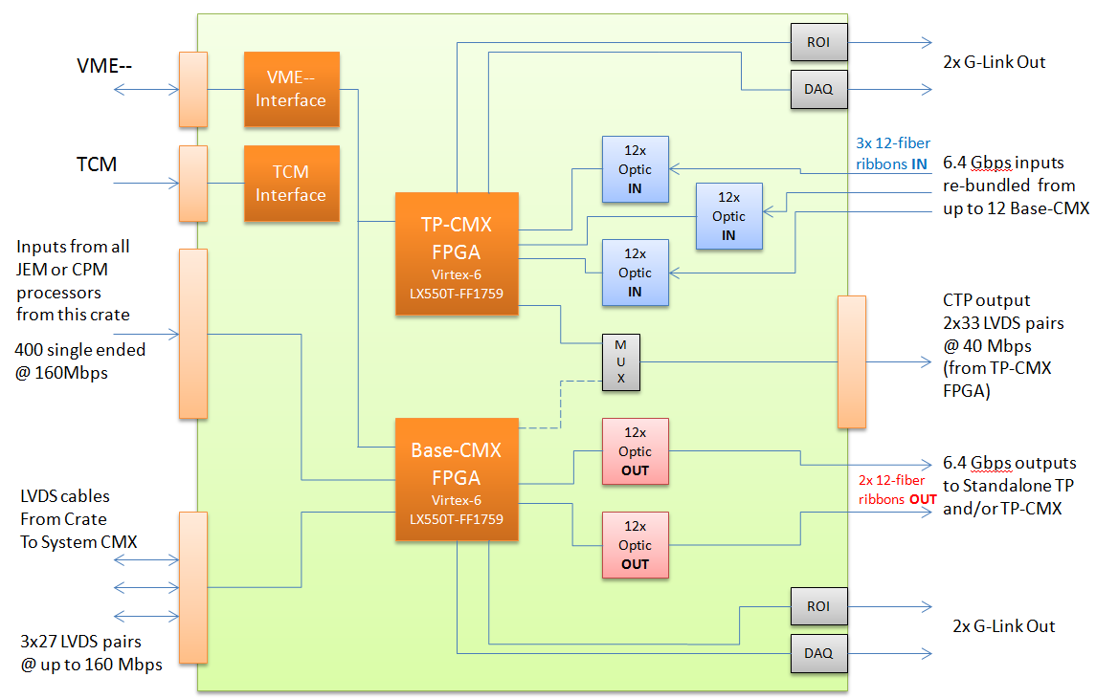
Atlas L1Calo CMX Card
CMX is upgrade of CMM with higher capacity
Inputs from JEM or CPM modules
40 → 160Mbps (400 signals)
Crate CMX to System CMX Cable IO
40 → 160Mbps (81 signals)
Output to CTP
40 → 80Mbps (66 signals)
Bigger FPGA (Xilinx Virtex 6 VLX550T)
e.g. for additional thresholds
Functionality new to CMX
Cluster information sent by each CMX to Topological Processor
Two 12-fiber ribbons of optical output @6.4Gbps per fiber
Optional partial TP capability included
A Standalone TP is being built but some TP capability is still desirable on the CMX platform
Three 12-fiber ribbons of optical input at @6.4Gbps per fiber
Separate Virtex 6 FPGA used for TP Functionality (optionally installed)
Most CMX cards will be built without the TP FPGA installed
MSU 29-Aug-2012

Slide 2
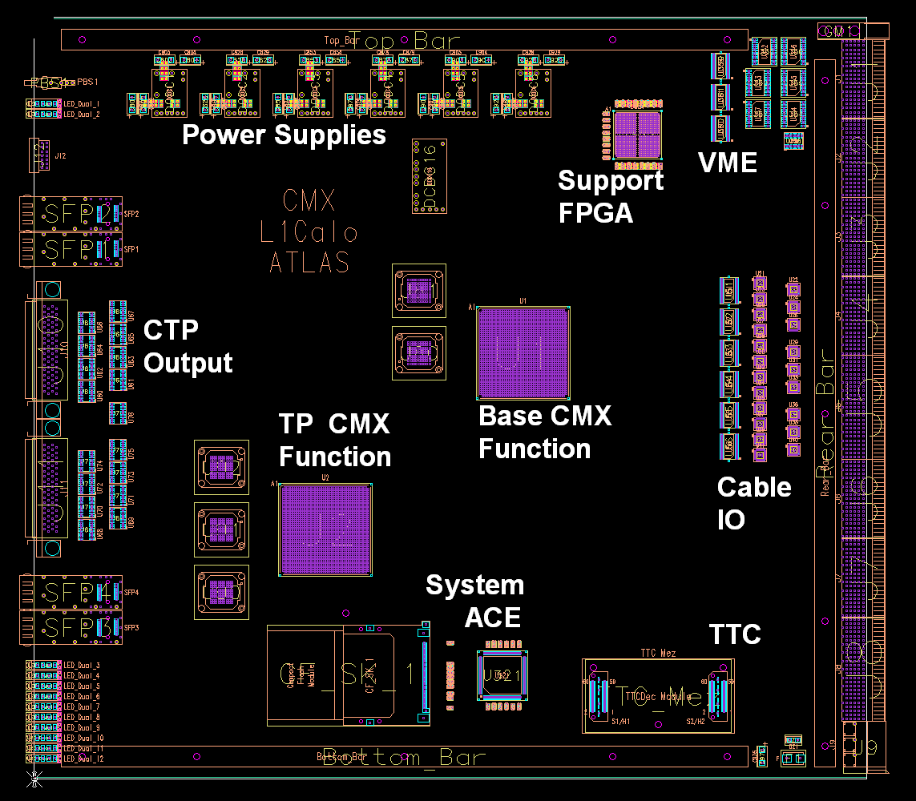
Atlas L1Calo CMX Card
Main Data Path
Backplane Inputs, Cable IO and CTP Output all understood
Maximized signal integrity
Critical for 160Mbps bandwidth
All critical signals between ground planes
PCB trace layout optimized (no extra vias)
Pin assigment verified for firmware routability
24-layer card
Working on details of Optical IO
Ancillary Functions
Understanding Power issues
Sizing power supplies
Need to satisfy firmware requirements
Investigating FPGA heat dissipation
Working on Clock Distribution
All clocks and IOs are synchronized to TTC
Optimizing overall parts placement
MSU 29-Aug-2012

Slide 3
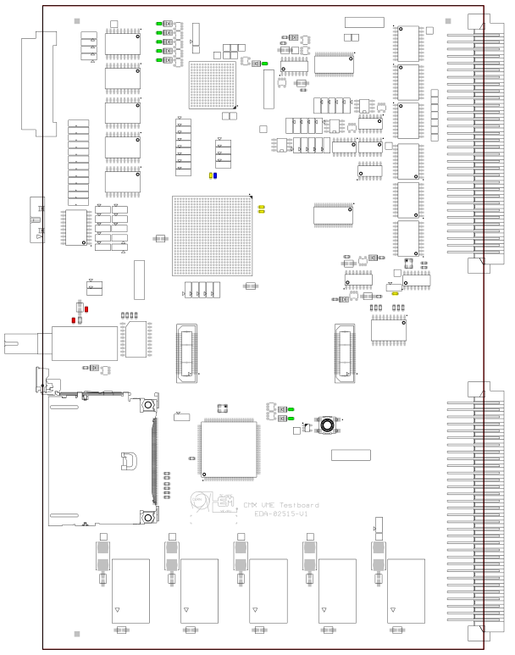
Atlas L1Calo CMX Card
VAT card: parallel effort and study platform
VME/ACE/TTC (VAT) ancillary functions of CMX
Redesign of CMM with new components
Most ancillary functions fit in single Support FPGA
Build a 6U VME test card
Include a small Virtex 6
Practice firmware configuration via System ACE
Test bed of operating environment for CMX
Can start design of CMX control Software
Lessons and details to be merged into CMX
PCB done June 2012
Currently working on
Firmware for VAT card
Test Firmware for Virtex 6 FPGA
Test Stand and software
MSU 29-Aug-2012

