Slide 1
CMX Production Status
Presented to the L1Calo Meeting
on Monday 22-Sept-2014
by Dan Edmunds for the CMX Group

Slide 2
This talk describes the production of the CMX cards, the problem that we had with the backplane connectors on some of these cards, and the outlook for delivery of cards for the M6 test and the completion of all CMX cards.
The CMX cards were produced in a prototype build of 4 cards in February 2014 and a production build of 20 cards in June 2014.

Slide 3
In addition to the 7 CMX cards that were at CERN, we shipped an additional 4 cards to be installed for the M5 test. That test began on September 8th. These 4 cards were in Geneva by August 29th.
We currently have 2 more cards at MSU that are tested and ready to use. One of these cards is a dual Virtex card that I prefer not to ship to CERN at this time.

Slide 4
We have 1 additional card that is through the MSU Final Assembly process and ready for MSU Testing. Currently I’m not working on testing that card.
Rather I’m working with the a ”first article” card that has had its backplane connectors replaced.

Slide 5
During the June build of the 20 production CMX cards there were 9 cards that I did not accept because of poor alignment of their backplane connectors. Typically these connectors had been pressed in too far. Originally the assembly house was going to replace the backplane connectors on these 9 cards. I did not pressure the assembly house to immediately do this repair work because I was working with the other 11 production cards and I wanted to give them time to develop a safe effective re-work process to replace these connectors.

Slide 6
By the beginning of September they were still having trouble developing a method to replace the backplane connectors in a way that I felt was safe for the rest of the card. We mutually decided that it was best if they sent out these 9 cards to a re-work house that specializes in this type of repair work. The original assembly house is paying for this specialized re-work.

Slide 7
I asked to examine a ”first article” card with replaced connectors before I would approve work on the other 8 cards. I received the first article card late Thursday afternoon September 18th. In testing this card I specifically want to verify that all 400 processor connections to the backplane are working correctly. That is a test that we do during MSU Testing of all of CMX cards. I hope to give the go ahead to replace the backplane connectors on the remaining 8 cards by Tuesday September 23rd. The rework of these remaining 8 cards is expected to take one week.

Slide 8
As you may have heard, at one time we were having trouble with one SFP optical transmitter on one CMX card. During the testing of subsequent production cards we found the same problem with the same or different SFP transmitter channel on a few other cards. We now know that in all cases these SFP transmitters work fine if their associated GTX transceiver is given a single reset after the FPGA is Configured. After one transceiver reset we have not seen any SFP errors on any channels for as long as we have run tests.

Slide 9
As far as I know at this time we will not have a problem supplying 4 more tested standard production CMX cards for the M6 test in October.
As far as I know at this time we will not have a problem completing MSU Final Assembly and MSU Testing of all 24 of the CMX cards.

Slide 10
The following is a link to the current CMX Card Production Status. This file gives the status of each CMX card and includes notes and information about the production of the CMX cards.
http://www.pa.msu.edu/hep/atlas/l1calo/cmx/hardware/details/cmx_production_status.txt
The final slides of this talk are a snapshot from this CMX production status file and provide a line of information about each of the 24 CMX cards.

Slide 11
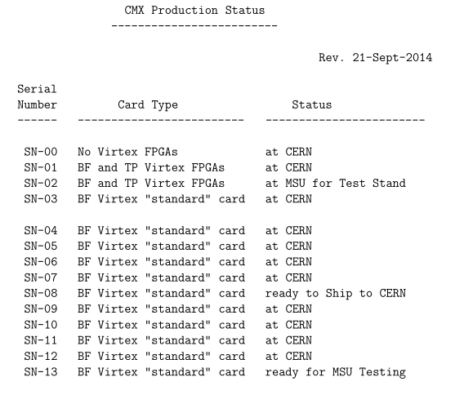

Slide 12
