Slide 1
Status of CMX design studies
Philippe Laurens, MSU
8-Feb-2012
@RAL

Slide 2
CMX development work on 3 fronts
VME/ACE/TTC interface “daughter card” @CERN
Yuri
CMX input module firmware @CERN
Wojciech and Yuri
Engineering @MSU
Philippe and Dan
Only focusing on #3 today

Slide 3
CMX Project’s Goals for this meeting
We would like a short term outcome of this meeting to be:
“Yes/No” on continue designing for CMX-TP
and agreement on approach
Agreement on FPGA choice
Agreement on 10Gb output option

Slide 4
Initial CMX design studies phase
Trying to address two main questions
FPGA choice for implementing the Base-CMX functionality
Strategies, costs and risks for adding Topological Processing capability to the CMX platform
Guidance from Stockholm review
Use Virtex 6
Evaluate FF1924 & FF1923 packages
Design for 6.4Gb optical outputs
Implement G-link encoding on FGPA
→ be conservative to deliver on time

Slide 5
Definition: Base-CMX functionality
All of CMM functionality (both Crate CMM and System CMM)
Receive and process 400 JEM/CPM input signals (4x higher rate)
Crate CMXs send local summary to System CMX through backplane connector over LVDS cables (2x higher rate probably desirable)
System CMXs form and send triggering information to CTP over LVDS cables (same as CMM)
all CMXs send ROI and DAQ information over G-links (same as CMM)
Send JEM/CPM info out to a TP optically
using 12-fiber bundles
with some level of duplication (at least 2x copies sent)
6.4Gbps nominally sufficient for all raw data on one 12-fiber bundle
also possible to send zero-suppressed data on less fibers
SNAP12 (modified) or miniPOD available from Avago up to 10Gbps

Slide 6
Definition: TP-CMX functionality
Topological Processing capability on CMX platform
Receive optical inputs from each of 12x CMXs
Run multiple Topological Algorithms
Send Topological triggering information to CTP
TP-CMX functionality is needed if dedicated TP not built, or availability delayed, or as additional safety/backup
The CMX platform would then be asked to provide as much generic TP functionality as possible.
When all final TP decisions can be made is not clear.

Slide 7
Nota Bene
Distinction between locally and globally derived triggering information
Any Trigger Information that can be derived locally and then gathered/summed into an overall summary
can use the Crate->System path
e.g. implementing additional thresholds
An Algorithm that correlates geographically separated or different types (e.g. electron vs jet) of information
needs TP architecture

Slide 8
Overview/Review of possible use cases
Illustrated in following diagrams…
CMM emulation only
Base-CMX functionality only
Send data to Standalone TP
TP-CMX functionality used
Only CMX-TP
Both CMX-TP and Standalone TP

Slide 9
1. CMX emulation of CMM functionality (no TP involved)
Energy
Jet
Electron
Tau
Base-
CMX
Funct
Base-
CMX
Funct
Base-
CMX
Funct
Base-
CMX
Funct
Base-
CMX
Funct
Base-
CMX
Funct
Base-
CMX
Funct
Base-
CMX
Funct
Crate
CMXs
- - - - - - - -
LVDS
Cables
LVDS
Cables
LVDS
Cables
LVDS
Cables
System
CMXs
Base-
CMX
Funct
Base-
CMX
Funct
Base-
CMX
Funct
Base-
CMX
Funct
to CTP
to CTP
to CTP
to CTP

Slide 10
2. Standalone TP receiving Raw CMX Inputs
Energy
Jet
Electron
Tau
Base-
CMX
Funct
Base-
CMX
Funct
Base-
CMX
Funct
Base-
CMX
Funct
Base-
CMX
Funct
Base-
CMX
Funct
Base-
CMX
Funct
Base-
CMX
Funct
Crate
CMXs
- - - - - - - -
LVDS
Cables
12
LVDS
Cables
LVDS
Cables
LVDS
Cables
System
CMXs
1 x 12-fiber bundle
Base-
CMX
Funct
Base-
CMX
Funct
Base-
CMX
Funct
Base-
CMX
Funct
to CTP
to CTP
to CTP
to CTP
12 x 12 fibers
Standalone
Topological
Processor
to CTP

Slide 11
3. Standalone TP receiving Zero-Suppressed CMX Inputs
Energy
Jet
Electron
Tau
Base-
CMX
Funct
Base-
CMX
Funct
Base-
CMX
Funct
Base-
CMX
Funct
Base-
CMX
Funct
Base-
CMX
Funct
Base-
CMX
Funct
Base-
CMX
Funct
Crate
CMXs
- - - - - - - -
LVDS
Cables
12
System
CMXs
LVDS
Cables
LVDS
Cables
LVDS
Cables
1 x 12-fiber bundle
Base-
CMX
Funct
Base-
CMX
Funct
Base-
CMX
Funct
Base-
CMX
Funct
to CTP
to CTP
to CTP
to CTP
12 x 12 fibers
Optical Fiber “Re-Bundler”
Standalone
Topological
Processor
N x 12
to CTP

Slide 12
4. One (or more) CMX TP receiving Zero-Suppressed Inputs
Energy
Jet
Electron
Tau
to CTP
to CTP
TP-
CMX
Funct
TP-
CMX
Funct
TP-
CMX
Funct
TP-
CMX
Funct
TP-
CMX
Funct
TP-
CMX
Funct
TP-
CMX
Funct
TP-
CMX
Funct
Base-
CMX
Funct
Base-
CMX
Funct
Base-
CMX
Funct
Base-
CMX
Funct
Base-
CMX
Funct
Base-
CMX
Funct
Base-
CMX
Funct
Base-
CMX
Funct
Crate
CMXs
- - - - - - - -
LVDS
Cables
12
LVDS
Cables
LVDS
Cables
LVDS
Cables
System
CMXs
TP-
CMX
Funct
TP-
CMX
Funct
TP-
CMX
Funct
6 x 12 fibers
TP-
CMX
Funct
1 x 12-fiber bundle
Base-
CMX
Funct
Base-
CMX
Funct
Base-
CMX
Funct
Base-
CMX
Funct
Optical Fiber “Re-Bundler”
to CTP
to CTP
to CTP
to CTP
12 x 12 fibers

Slide 13
5. CMX TP & Standalone TP receiving Zero-Suppressed Inputs
Energy
Jet
Electron
Tau
to CTP
TP-
CMX
Funct
Base-
CMX
Funct
Base-
CMX
Funct
Base-
CMX
Funct
Base-
CMX
Funct
Base-
CMX
Funct
Base-
CMX
Funct
Base-
CMX
Funct
Base-
CMX
Funct
Crate
CMXs
- - - - - - - -
LVDS
Cables
12
LVDS
Cables
LVDS
Cables
LVDS
Cables
System
CMXs
6 x 12 fibers
1 x 12-fiber bundle
Base-
CMX
Funct
Base-
CMX
Funct
Base-
CMX
Funct
Base-
CMX
Funct
Optical Fiber “Re-Bundler”
to CTP
to CTP
to CTP
to CTP
12 x 12 fibers
Standalone
Topological
Processor
to CTP
6 x 12 fibers

Slide 14
6. CMX TP receiving Zero-Suppressed Inputs & Standalone TP raw inputs
Energy
Jet
Electron
Tau
to CTP
TP-
CMX
Funct
Base-
CMX
Funct
Base-
CMX
Funct
Base-
CMX
Funct
Base-
CMX
Funct
Base-
CMX
Funct
Base-
CMX
Funct
Base-
CMX
Funct
Base-
CMX
Funct
Crate
CMXs
- - - - - - - -
LVDS
Cables
12
LVDS
Cables
LVDS
Cables
LVDS
Cables
System
CMXs
6 x 12 fibers
2 x 12-fiber bundle
Base-
CMX
Funct
Base-
CMX
Funct
Base-
CMX
Funct
Base-
CMX
Funct
Optical Fiber “Re-Bundler”
to CTP
to CTP
to CTP
to CTP
to CTP
12 x 12 fibers
Standalone
Topological
Processor
12 x 12 fibers

Slide 15
Base-CMX Implementation
Question #1:
FPGA choice for implementing the Base-CMX functionality

Slide 16
Base-CMX Implementation
400x 160Mbps backplane inputs
routed directly to FPGA, no termination on CMX
merged parity and clock
cannot afford 1x IO block per source JEM/CPM processor
but need regrouping in neighbor IO blocks
Processor sources spread out on backplane connectors
Up to 3x 12 “6Gb” optical transceivers (2 out, 1 in)
multi gigabit transmission lines
need careful layout and field simulation tools
use mid-board transmitters for shorter traces
need optical power study of whole optical distribution
compete for access to, and real estate near, FPGA
will need protocol to transfer 12x 6.4 Gbps of payload + overhead
XILINX notes have example
needs external oscillator, not necessarily synchronous with accelerator
Large FPGA package require many trace layers

Slide 17
A. CMX Card with only Base-CMX functionality
VME--
VME-- Interface
TCM
TCM Interface
1x 12-fiber
Bundles IN
12x Optic IN
6.6 Gbps
Test input
Inputs from all
Processors
from this crate
400 single ended
@ 160Mbps
CTP output
2x33 LVDS pairs
@ 40 Mbps
(System CMX)
Base-CMX FPGA
Virtex-6
LVDS cables
From Crate
To System CMX
12x Optic OUT
6.6 Gbps
to TP-SA
2x 12-fiber
Bundles OUT
6.6 Gbps
(or 10 Gb **)
12x Optic OUT
ROI
2x G-Link Out
3x27 LVDS pairs
@ 80 Mbps
DAQ
** 10Gb output to TP-Standalone option to be determined
Notes:
This is the absolute minimum card, replacing the CMM functionality, with input rates increased to 160Mbps, and sending the backplane information optically to a Topological Processor.

Slide 18
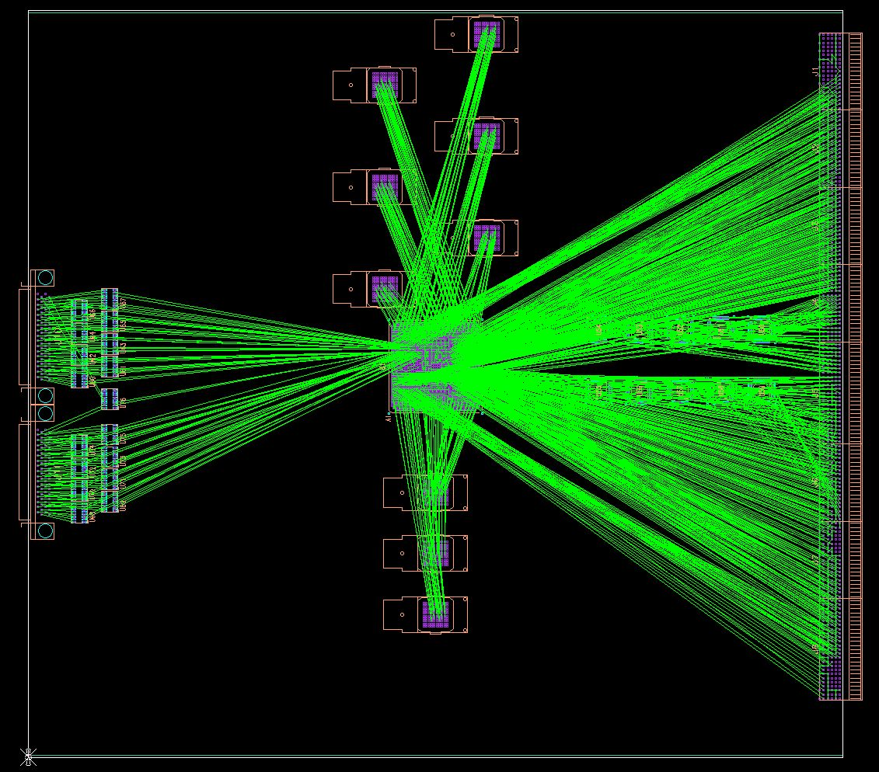
Package Choice and Pin Assignment
Made toy layouts using several packages
Focusing on main signal flow (PreProc In, Cable IO, CTP Out)
Helps visualizing challenges
Example: Toy Pin Assignment study

Slide 19
FF1924
Select IO
Resources
MGT Resources
MGT Resources
Select IO
Resources

Slide 20
FF1924
MGT Resources
Select IO
Resources
Select IO
Resources
Front Panel Side
Backplane Side
Rotated
MGT Resources

Slide 21
FF1924
320 PreProc Inputs

Slide 22
FF1924
40 PreProc IN
320 PreProc Inputs
40 PreProc IN

Slide 23
FF1924
MGT Resources
40 PreProc IN
320 PreProc Inputs
66 CTP Out
81 Cable IO
40 PreProc IN
MGT Resources

Slide 24
FF1924 ➔ Too tight
Contention
MGT Resources
40 PreProc IN
320 PreProc Inputs
66 CTP Out
IO Resources Left
81 Cable IO
40 PreProc IN
MGT Resources
Contention

Slide 25
FF1923
MGT Resources
Select IO
Resources
Select IO
Resources
MGT Resources

Slide 26
FF1923 ➔ Better
MGT Resources
66 CTP Out
400 PreProc Inputs
IO Resources Left for VME, optic control, etc
81 Cable IO
MGT Resources

Slide 27
Another package…?
Base-CMX doesn’t need/use all the available MGT resources of FF1923
Especially if CMX does not need to operate as TP, there is another interesting package: FF1759
Fewer MGT resources
More Select IO resources
Similar Logic Resources
Slightly smaller footprint (→ less trace layers)
Cheaper

Slide 28
FF1759
Select IO
Resources
MGT Resources

Slide 29
FF1759
400 Pre
Proc In
66 CTP Out
81 Cable IO
MGT Resources
boxes shape and
location is an
approximation
for illustration
of scale

Slide 30
FF1759 ➔ Preferred Choice
Fewer rows of pads
4 or 5 Fewer
Trace Layers
400 Pre
Proc In
66 CTP Out
81 Cable IO
MGT Resources

Slide 31
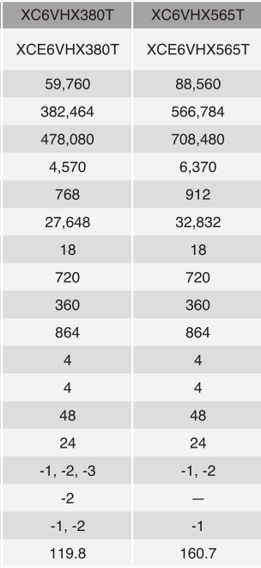
Resource Comparison
FF1759
FF1924 or FF1923
Very
Similar
Fewer GTX
Zero GTH

Slide 32
Base-CMX Implementation
Question #1:
FPGA choice for implementing the Base-CMX functionality
Recommendation:
Use LX550T FF1759
(especially If CMX doesn’t need to perform as a TP)

Slide 33
TP-CMX Functionality
Question #2:
Strategies, costs and risks for adding Topological Processing capability to the CMX platform

Slide 34
TP-CMX Functionality
Add as many optical inputs as possible to receive info from 12x CMX cards
requires intermediate fiber re-bundler box to go from 12x12 to 5x or 6x12
same box could provide 2x sets of upper/lower outputs without optical split
Add another 2x GTX outputs for 2 more G-links for TP ROI and DAQ
Need access to output driver to CTP (not a problem)
Intrinsic complications when using Virtex 6 GTH resources
GTH inputs (2x12 of 5x or 6x) are not capable of 6.6 Gbps operation
because internal PLL is narrow range
5.5Gb is compatible with both GTX and GTH
need two more power supplies for GTH transceivers
higher power (~2x) for GTH (3.6 W per 12) vs GTX (1.9W per 12 at 5.5Gb)

Slide 35
CMX-TP : Single FPGA Solution
Constraints
cannot be FF1759, has to be FF1923
5x12 GTX/GTH inputs (i.e. 4 more than Base-CMX only)

Slide 36
B. CMX Card with TP capability on same FPGA
ROI
VME--
VME-- Interface
2x G-Link Out
DAQ
12x Optic IN
12x Optic IN
5x 12-fiber
Bundles IN
TCM
TCM Interface
Re-bundled
from
12x Base-CMX
@6.6 or 5.5 Gb
12x Optic IN
Inputs from all
Processors
from this crate
12x Optic IN
12x Optic IN
CTP output
2x33 LVDS pairs
@ 40 Mbps
(System CMX
or TP-CMX)
400 single ended
@ 160Mbps
Base-CMX FPGA
Virtex-6
LVDS cables
From Crate
To System CMX
12x Optic OUT
6.6 Gbps (or 5.5 *)
e.g. to TP-CMX
2x 12-fiber
Bundles OUT
e.g. to TP-SA
6.6 Gbps (or 10 **)
12x Optic OUT
ROI
2x G-Link Out
3x27 LVDS pairs
@ 80 Mbps
DAQ
* TP-CMX GTH inputs not capable of 6.6 Gbps
** 10Gb output to TP-Standalone option to be determined
Notes:
This is the June vision in order to include TP processing capability on the CMX platform.

Slide 37
CMX-TP : Single FPGA Solution
Cons
forego advantages from FF1759 (ruled out because not enough MGT resources)
total of >= 88 MGT signal pairs; 50 additional from Base-CMX
competes with Base-CMX functionality for real estate & access
very crowded near FPGA
makes Base-CMX layout more complicated
increase risk of electrical interference
Ties firmware for Base-CMX with firmware for TP-CMX
makes commissioning/evolution of CMX-TP firmware operationally risky for Base-CMX operation
share total available logic resources between these two separate functions

Slide 38
CMX-TP vs Base-CMX
So there is contention…
Can this be helped?

Slide 39
CMX-TP vs Base-CMX
Observations
Base-CMX and TP are totally separate functions
logically, don't share inputs or outputs (unlike Crate vs System)
operationally in separate latency time segments
only share VME bus, TTC, ...
TP-CMX needs access to CTP output, but we can simply not choose a System CMX to operate as a TP-CMX
Still not clear if TP-CMX functionality is ultimately needed or desired (as backup) and/or used
Still not clear how and when we would know for sure that CMX-TP will be used or not
Merging Base-CMX ant TP-CMX firmware in one design and one bitstream still seems unwise
We even originally proposed to use a separate CMX in a separate crate

Slide 40
CMX-TP : Dual FPGA Solution
Add a second FPGA for just TP-CMX functionality
Pick optimal FF1924 package with most MGT resources for TP-CMX
Keep optimal FF1759 package for Base-CMX
→division of tasks & risks between FPGAs

Slide 41
CMX-TP : Dual FPGA Solution
Pros
Easier commissioning, easier operation, easier firmware mgmt and upgrade
One more 12-fiber input bundle for TP-CMX (6x12 instead of 5x for FF1923)
Leverage advantages of FF1959 package precluded in single FPGA solution
Divide routing challenges
backplane processor and cable inputs located in one area
Majority of high frequency requirements of MGT resources in other area
Expected to translate into more flexibility, shorter traces
lower chances for electrical interferences
Separate MGT transmitters from receivers
→ Prevent TP-CMX “luxury” from interfering with Base-CMX “necessity”
…and if decision on Standalone TP needs to be further delayed
could abandon TP-CMX part of layout during design phase without impact on Base-CMX
rip out or leave unpopulated
Also could abandon TP-CMX before production assembly
not populate TP-CMX location on production boards
modify layout if needed or try and prepare for it (cf. modified solution below)

Slide 42
C. CMX Card with TP capability on separate FPGA
ROI
VME--
VME-- Interface
2x G-Link Out
DAQ
12x Optic IN
12x Optic IN
6x 12-fiber
Bundles IN
TCM
TCM Interface
Re-bundled
from
12x Base-CMX
@6.6 or 5.5 Gb
12x Optic IN
Inputs from all
Processors
from this crate
TP-CMX FPGA
Virtex-6
12x Optic IN
12x Optic IN
CTP output
2x33 LVDS pairs
@ 40 Mbps
(System CMX
or TP-CMX)
400 single ended
@ 160Mbps
12x Optic IN
MUX
Base-CMX FPGA
Virtex-6
LVDS cables
From Crate
To System CMX
12x Optic OUT
6.6 Gbps (or 5.5 *)
e.g. to TP-CMX
2x 12-fiber
Bundles OUT
e.g. to TP-SA
6.6 Gbps (or 10 **)
12x Optic OUT
ROI
2x G-Link Out
3x27 LVDS pairs
@ 80 Mbps
DAQ
* TP-CMX GTH inputs not capable of 6.6 Gbps
** 10Gb output to TP-Standalone option to be determined
Notes:
This is the current thinking that optimizes trace layout, maximize functionality and flexibility, while minimizing design and operational risk.

Slide 43
CMX-TP : Dual FPGA Solution
cons
Two FPGAs means more expensive
~1.5x in FPGA cost (FF1924+FF1759 instead of FF1923)
or ~2x in FPGA cost (FF1924+FF1923 instead of FF1923)
cf. table later on…

Slide 44
4. One (or more) CMX TP receiving Zero-Suppressed Inputs
Energy
Jet
Electron
Tau
to CTP
to CTP
Un-used
FPGA
Un-used
FPGA
Un-used
FPGA
Un-used
FPGA
TP-
CMX
FPGA
TP-
CMX
FPGA
Un-used
FPGA
Un-used
FPGA
Base-
CMX
FPGA
Base-
CMX
FPGA
Base-
CMX
FPGA
Base-
CMX
FPGA
Base-
CMX
FPGA
Base-
CMX
FPGA
Base-
CMX
FPGA
Base-
CMX
FPGA
Crate
CMXs
- - - - - - - -
LVDS
Cables
12
LVDS
Cables
LVDS
Cables
LVDS
Cables
System
CMXs
Un-used
FPGA
Un-used
FPGA
Un-used
FPGA
6 x 12 fibers
Un-used
FPGA
1 x 12-fiber bundle
Base-
CMX
FPGA
Base-
CMX
FPGA
Base-
CMX
FPGA
Base-
CMX
FPGA
Optical Fiber “Re-Bundler”
to CTP
to CTP
to CTP
to CTP
12 x 12 fibers
Notes:
A modification of the June idea, but abandoning the single-FPGA package – CMX C.

Slide 45
Dual FPGA solution = more expensive
Can this be helped?

Slide 46
Modified Dual FPGA Solution
TP functionality only used on one (or few) CMX boards
TP-CMX FPGA thus unused in all but few of the boards
Initial goal was to have all cards be the same…
but wasteful/expensive for dual FPGA CMX
→ Build two flavors of CMX cards
A few (2-4) with both FPGAs
The bulk with just the Base-CMX FPGA
Could be exact same layout or close derivative
NOT a separate design, and plan for this option from start
Intent is that same circuit board can be assembled into either specie
Share some of the assembly setup costs (less parts in one)
Layout review option between prototype and production

Slide 47
Modified Dual FPGA Solution
Pros
keep all advantages of Dual FPGA solution
Avoid cost escalation of expensive second FPGA unused on bulk of cards
Cons
Breaks l1calo "tradition" of all identical boards
Some aspects of operation/mgmt will need tailoring
Two types of boards, but one is superset of other

Slide 48
C-prime. CMX Card with TP capability unused/unpopulated
ROI
VME--
VME-- Interface
DAQ
12x Optic IN
TCM
TCM Interface
12x Optic IN
12x Optic IN
Inputs from all
Processors
from this crate
TP-CMX FPGA
Virtex-6
12x Optic IN
12x Optic IN
400 single ended
@ 160Mbps
12x Optic IN
CTP output
2x33 LVDS pairs
@ 40 Mbps
(System CMX)
MUX
Base-CMX FPGA
Virtex-6
LVDS cables
From Crate
To System CMX
12x Optic OUT
6.6 Gbps (or 5.5 *)
e.g. to TP-CMX
2x 12-fiber
Bundles OUT
e.g. to TP-SA
6.6 Gbps (or 10 **)
12x Optic OUT
ROI
2x G-Link Out
3x27 LVDS pairs
@ 80 Mbps
DAQ
* TP-CMX GTH inputs not capable of 6.6 Gbps
** 10Gb output to TP-Standalone option to be determined
Notes:
This is the current thinking that optimizes trace layout, maximize functionality and flexibility, while minimizing design and operational risk.

Slide 49
4-prime. One (or more) CMX TP receiving Zero-Suppressed Inputs
Energy
Jet
Electron
Tau
to CTP
to CTP
TP-
CMX
FPGA
TP-
CMX
FPGA
Base-
CMX
FPGA
Base-
CMX
FPGA
Base-
CMX
FPGA
Base-
CMX
FPGA
Base-
CMX
FPGA
Base-
CMX
FPGA
Base-
CMX
FPGA
Base-
CMX
FPGA
Crate
CMXs
- - - - - - - -
LVDS
Cables
12
LVDS
Cables
LVDS
Cables
LVDS
Cables
System
CMXs
6 x 12 fibers
1 x 12-fiber bundle
Base-
CMX
FPGA
Base-
CMX
FPGA
Base-
CMX
FPGA
Base-
CMX
FPGA
Optical Fiber “Re-Bundler”
to CTP
to CTP
to CTP
to CTP
12 x 12 fibers
Notes:
A cheaper configuration using both CMX A and CMX C in different roles. No TP assumed.

Slide 50
Cost Estimate for FPGAs
 | Option | FPGA Base | Packg Base | FPGA TP | Packg TP | FPGA(s) Q=1 ** | Total Q=15 | Total Q=4+11
1 | Base CMX, 6Gb out, no TP | LX550T | FF1759 |  |  | $5.5k | $83k
2 | Single FPGA, Base 6Gb out, TP 5Gb in | HX565T | FF1923 |  |  | $8.5k | $128k
3 | Dual FPGA, Base 6Gb out, TP 5Gb in | LX550T | FF1759 | HX565T | FF1924 | $14k | $210k
4 | #3, build 2-4 with TP, 11-13 without TP |  |  |  |  |  |  | $117k
(**) DigiKey Q=1 price from website, rounded up. May get quantity and/or research discount. Waiting on quotes from AVnet.
6Gb out: need >6.4Gb on 12 fibers to send raw data + link control protocol + payload signaling protocol. GTX specified up to 6.6 Gb.
5Gb in: shortened label for maximum rate that a Base-CMX GTX output can send to a TP-CMX GTH input (5.59 Gb in specs).
HX565T could be replaced with HX380T, with less logic resources, but higher speed grade available (+10%), for +$3k each

Slide 51
TP-CMX Functionality
Question #2:
Strategies, costs and risks for adding Topological Processing capability to the CMX platform
Recommendation: Dual FPGA solution
Base-CMX use LX550T FF1759
TP-CMX use LX565T FF1924
Build majority of CMX without TP-CMX FPGA

Slide 52
Appendix
10Gbps output to Standalone TP

Slide 53
10Gb motivation
from TP point of view
Send more data (but not clear what)
Or use less fibers
Or reduce latency by a fraction of beam crossing
from CMX point of view
Why not if GTH resource is present and able
Optical transmitter capable of 2.5-10Gb anyway
a layout capable of >10Gb should be capable of <10Gb

Slide 54
10Gb output to Standalone TP
Frequency up by factor ~2
higher requirements on transmission lines
higher attenuation
trace length even more closely matched
smaller scale of imperfections that matters (e.g. vias, bends)
→ more complicated layout work
10Gb outputs not compatible with TP-CMX 6.6Gb inputs (5.5 Gb ok)
may matter if GTH output replaces one of the 2x12 GTX outputs
Need additional low jitter external oscillator for each frequency
Higher current draw for GTH transmitter
~4.25 W per 12-lane GTH at 10Gb (cf. ds152/p16) or 4.3W from XPE spreadsheet
vs. ~1.5W per 12-lane GTX at 3Gb (cf. ds152/p9) or 1.9W at 5.5Gb 2.1W at 6.6Gb
→ Change of scope with significant impact on our engineering resources and which will take away from insuring that the Base-CMX functionality will be delivered and work on time.

Slide 55
Additional impact on each option
1. Base-CMX only
Base-CMX FPGA cannot be FF1759; has to be FF1923
more layers
2x additional power supplies for GTH (1.1 and 1.8V)
additional oscillator
more expensive
2. TP-CMX: single FPGA solution
no difference in FPGA choice (already FF1923)
3&4. TP-CMX: dual FPGA solution
no difference in TP-CMX FPGA choice
Base-CMX FPGA cannot be FF1759; has to be FF1923
Cf. above

Slide 56
FPGA Cost increase for 10Gb option
 | Option | FPGA Base | Packg Base | FPGA TP | Packg TP | FPGA(s) Q=1 | Total Q=15 | Total Q=4+11 | Delta 10Gb
1 | Base CMX, 6Gb out | LX550T | FF1759 |  |  | $5.5k | $83k
1b | Base CMX, some 10Gb out | HX565T | FF1923 |  |  | $8.5k | $128k |  | +$45k
2 | Single FPGA, Base 6Gb out, TP 5Gb in | HX565T | FF1923 |  |  | $8.5k | $128k
2b | Single FPGA, Base 10Gb out, TP 5Gb in | HX565T | FF1923 |  |  | $8.5k | $128k |  | $0k
3 | Dual FPGA, Base 6Gb out, TP 5Gb in | LX550T | FF1759 | HX565T | FF1924 | $14k | $210k
3b | Dual FPGA, Base 10Gb out, TP 5Gb in | LX550T | FF1923 | HX565T | FF1924 | $17k | $255k |  | +$45k
4 | #3, build 2-4 with TP, 11-13 without TP |  |  |  |  |  |  | $117k
4b | #3b, build 2-4 with TP, 11-13 without TP |  |  |  |  |  |  | $161k | +$45k
10Gb out: maximum frequency of an Avago AFBR-810B SNAP12-style transmitter;or a bit more for Avago miniPOD

Slide 57
10Gb output to Standalone TP
Recommendation:
More stringent layout requirements
Adding risks to Base-CMX timely delivery
Zero benefit for CMX, unclear benefit for TP
Significant cost increase
→ Abandon 10Gb output idea

Slide 58
CMX Project’s Goals for this meeting
We would like a short term outcome of this meeting to be:
“Yes/No” on continue designing for CMX-TP
And agreement on approach
Agreement on FPGA choice
Agreement on 10Gb output option

