Slide 1
FOX demonstrator
Configuration for
LArDPS to eFEX Test
-- direct path
Rev: 07-Jan-2015

Slide 2
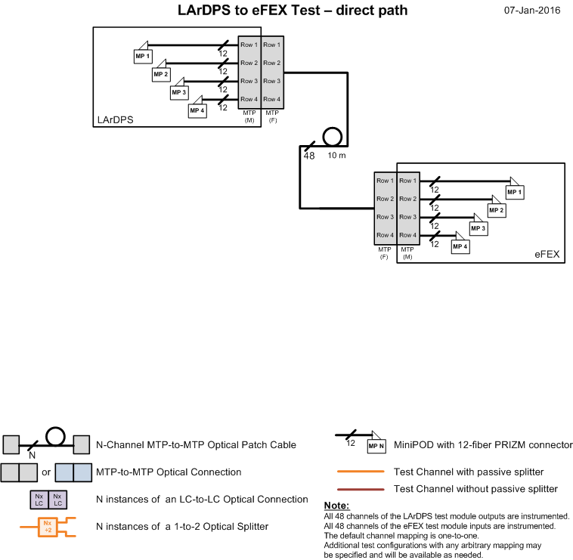
LArDPS to eFEX
Test Configuration
-- direct path
High level diagram
of LArDPS to eFEX
light path
(trivial case)
http://www.pa.msu.edu/hep/atlas/l1calo/fox/specification/2_demonstrator/figures/

Slide 3
LArDPS to eFEX Test Configuration – direct path: Optical Insertion Loss Measurement with CMX
48 Fibers
Trunk Cable
F
F
Above the line EXACTLY matches the setup planned for this FOX demonstrator test
MTP
MTP
LC/LC
M
M
12 Fibers
x12
M
MTP
Breakout Cable (48)
out
Breakout Cable (12)
CMX
F
48 Fibers
LC/LC
12 Fibers
x12
M
MTP
in
Breakout Cable (12)
Breakout Cable (48)
F
48 Fibers

Slide 4
LArDPS to eFEX Test Configuration – direct path: offset calibration with CMX
LC/LC
12 Fibers
x12
M
MTP
Direct LC-LC connections
out
Breakout Cable (12)
CMX
F
LC/LC
12 Fibers
x12
M
MTP
in
Breakout Cable (12)
F

Slide 5
LArDPS to eFEX Test Configuration – direct path: Optical Insertion Loss Measurement with Fluke handheld meter
48 Fibers
Trunk Cable
F
F
Above the line EXACTLY matches the setup planned for this FOX demonstrator test
MTP
MTP
M
M
Fluke
Source
LC/LC
Single Fiber SC-LC
x1
Breakout Cable (48)
48 Fibers
Fluke
Meter
LC/LC
x1
Single Fiber SC-LC
Breakout Cable (48)
48 Fibers

Slide 6
LArDPS to eFEX Test Configuration – direct path: offset calibration with Fluke handheld meter
Fluke
Source
LC/LC
Single Fiber SC-LC
x1
Direct LC-LC connection
Fluke
Meter
LC/LC
x1
Single Fiber SC-LC

Slide 7
FOX demonstrator
Configuration for
LArDPS to eFEX Test
-- without splitters

Slide 8
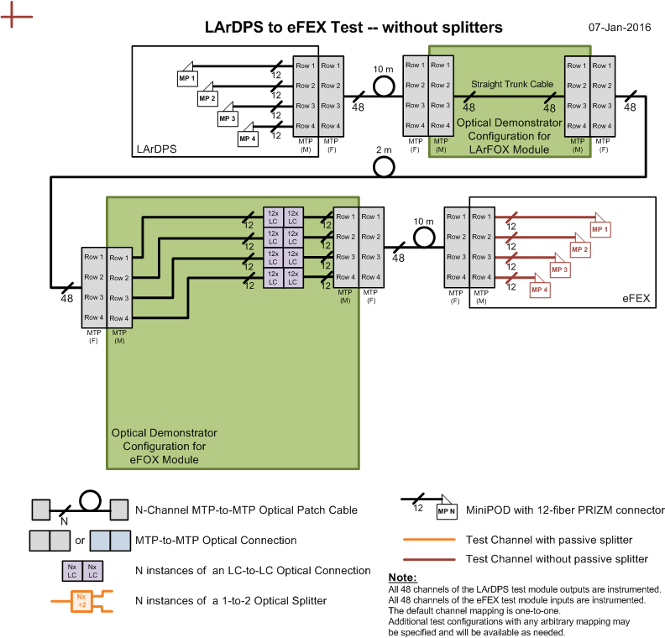
LArDPS to eFEX
Test Configuration
-- without splitters
High level diagram
of LArDPS to eFEX
light paths
http://www.pa.msu.edu/hep/atlas/l1calo/fox/specification/2_demonstrator/figures/

Slide 9
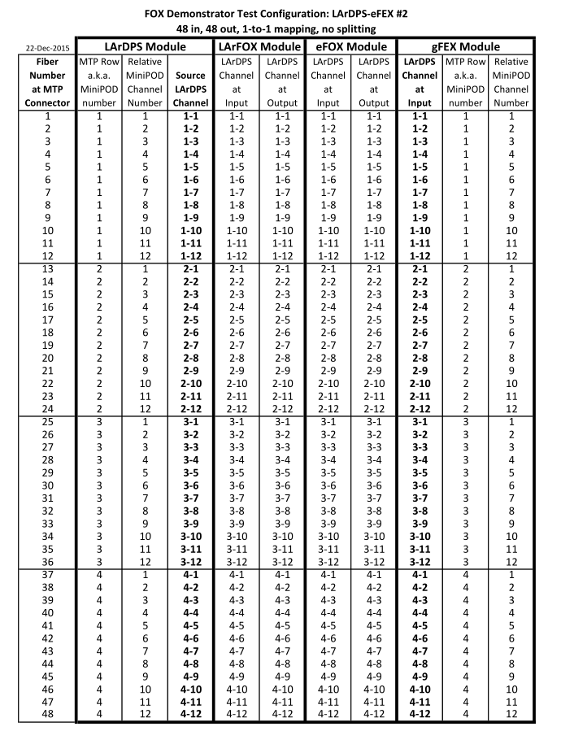
LArDPS to eFEX
Test Configuration
-- without splitters
Detailed connection map between all modules
http://www.pa.msu.edu/hep/atlas/l1calo/fox/specification/2_demonstrator/figures/

Slide 10
LArDPS to eFEX Test Configuration – without splitters: Optical Insertion Loss Measurement with CMX
LC/LC
Trunk Cable (48)
Breakout Cable (48)
Breakout Cable (48)
x48
M
in
M
out
M
in
M
out
(LArFOX)
(eFOX)
MTP
MTP
MTP
MTP
F
F
Trunk Cable (48)
F
F
Trunk Cable (48)
Trunk Cable (48)
F
F
Above the line EXACTLY matches the setup planned for this FOX demonstrator test
MTP
MTP
LC/LC
M
M
12 Fibers
x12
M
MTP
Breakout Cable (48)
out
Breakout Cable (12)
CMX
F
48 Fibers
LC/LC
12 Fibers
x12
M
MTP
in
Breakout Cable (12)
Breakout Cable (48)
F
48 Fibers

Slide 11
LArDPS to eFEX Test Configuration – without splitters: offset calibration with CMX – method #1
LC/LC
12 Fibers
x12
M
MTP
Direct LC-LC connections
out
Breakout Cable (12)
CMX
F
LC/LC
12 Fibers
x12
M
MTP
in
Breakout Cable (12)
F

Slide 12
LArDPS to eFEX Test Configuration – without splitters: offset calibration with CMX – method #2
48-Fiber
Trunk Cable
F
F
MTP
MTP
LC/LC
M
M
12 Fibers
x12
M
MTP
Breakout Cable (48)
out
Breakout Cable (12)
CMX
F
48 Fibers
LC/LC
12 Fibers
x12
M
MTP
in
Breakout Cable (12)
Breakout Cable (48)
F
48 Fibers

Slide 13
LArDPS to eFEX Test Configuration – without splitters: Optical Insertion Loss Measurement with Fluke handheld meter
LC/LC
Trunk Cable (48)
Breakout Cable (48)
Breakout Cable (48)
x48
M
in
M
out
M
in
M
out
(LArFOX)
(eFOX)
MTP
MTP
MTP
MTP
F
F
Trunk Cable (48)
F
F
Trunk Cable (48)
Trunk Cable (48)
F
F
Above the line EXACTLY matches the setup planned for this FOX demonstrator test
MTP
MTP
M
M
Fluke
Source
LC/LC
Single Fiber SC-LC
x1
Breakout Cable (48)
48 Fibers
Fluke
Meter
LC/LC
x1
Single Fiber SC-LC
Breakout Cable (48)
48 Fibers

Slide 14
LArDPS to eFEX Test Configuration – without splitters: offset calibration with Fluke -- method #1
Fluke
Source
LC/LC
Single Fiber SC-LC
x1
Direct LC-LC connection
Fluke
Meter
LC/LC
x1
Single Fiber SC-LC

Slide 15
LArDPS to eFEX Test Configuration – without splitters: offset calibration with Fluke -- method #2
Tentative decision : Not currently planning to use this time-intensive method
unless the CMX tests suggest otherwise
48-Fiber
Trunk Cable
F
F
MTP
MTP
M
M
Fluke
Source
LC/LC
Single Fiber SC-LC
1xx1
Breakout Cable (48)
48 Fibers
Fluke
Meter
LC/LC
x1
Single Fiber SC-LC
Breakout Cable (48)
48 Fibers

Slide 16
FOX demonstrator
Configuration for
LArDPS to eFEX Test
-- with splitters

Slide 17
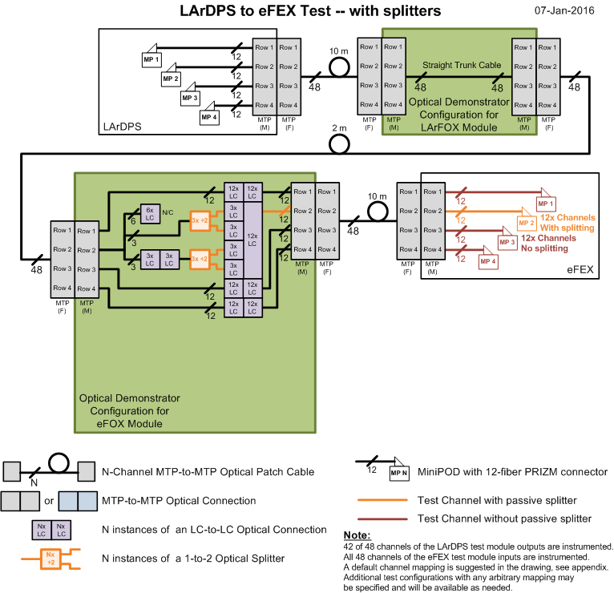
LArDPS to eFEX
Test Configuration
-- with splitters
High level diagram
of LArDPS to eFEX
light paths
http://www.pa.msu.edu/hep/atlas/l1calo/fox/specification/2_demonstrator/figures/

Slide 18
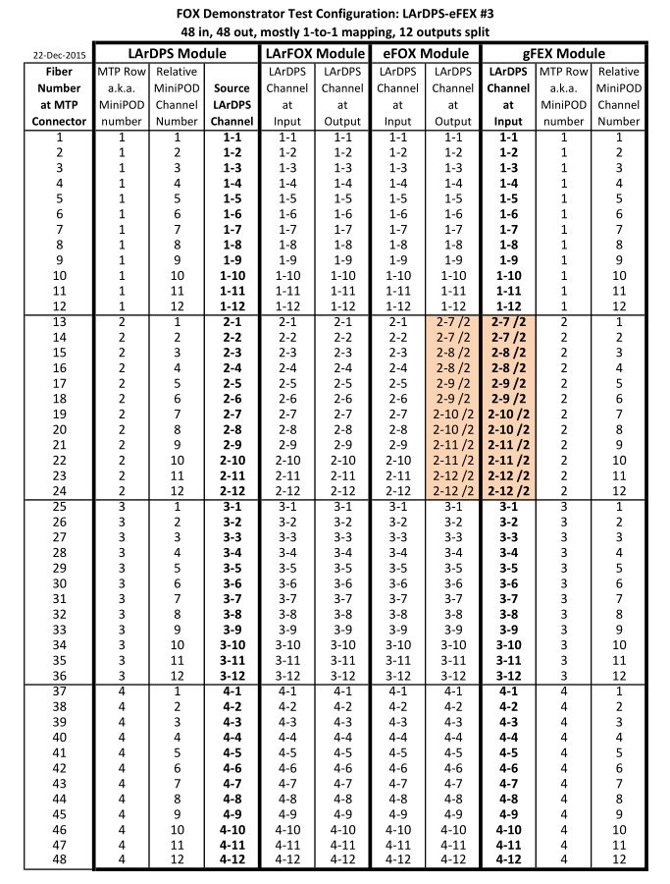
LArDPS to eFEX
Test Configuration
-- with splitters
Detailed connection map between all modules
(trivial in this case)
http://www.pa.msu.edu/hep/atlas/l1calo/fox/specification/2_demonstrator/figures/

Slide 19
LArDPS to eFEX Test Configuration – with splitters: Optical Insertion Loss Measurement with CMX
Breakout Cable (48)
With splittters
LC/LC
Trunk Cable (48)
Breakout Cable (48)
x48
x6
M
in
M
out
M
in
M
out
(LArFOX)
(eFOX)
MTP
MTP
MTP
MTP
F
F
Trunk Cable (48)
F
F
Trunk Cable (48)
Trunk Cable (48)
F
F
Above the line EXACTLY matches the setup planned for this FOX demonstrator test
MTP
MTP
LC/LC
M
M
12 Fibers
x12
M
MTP
Breakout Cable (48)
out
Breakout Cable (12)
CMX
F
48 Fibers
LC/LC
12 Fibers
x12
M
MTP
in
Breakout Cable (12)
Breakout Cable (48)
F
48 Fibers

Slide 20
LArDPS to eFEX Test Configuration – with splitters:
The same procedure that was illustrated for the measurements
of the LArDPS to eFEX Test Configuration without splitters
is also followed here for :
Offset calibration with CMX
Optical Insertion Loss Measurement with Fluke handheld meter
Offset calibration with Fluke

Slide 21
FOX demonstrator
Configuration for
LArDPS to gFEX Test
-- without splitters

Slide 22
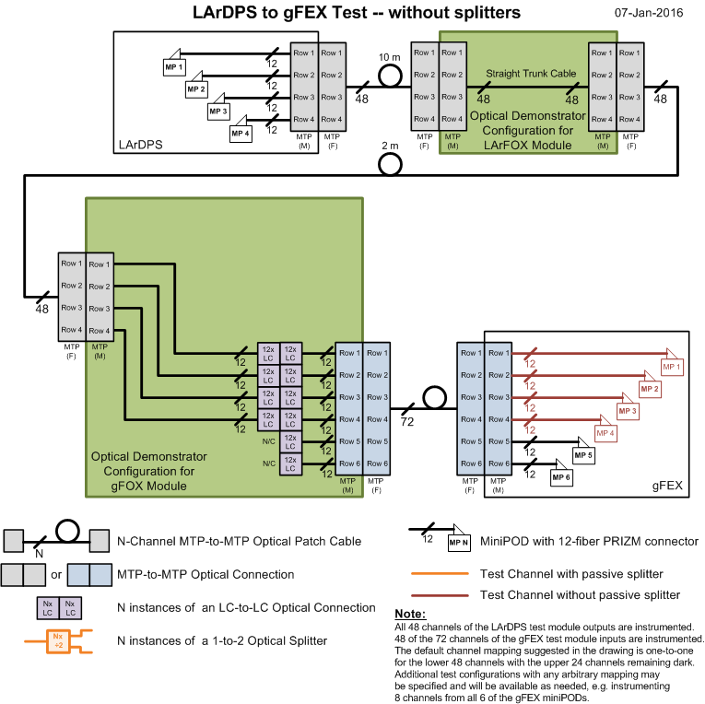
LArDPS to gFEX
Test Configuration
-- without splitters
High level diagram
of LArDPS to gFEX
light paths
http://www.pa.msu.edu/hep/atlas/l1calo/fox/specification/2_demonstrator/figures/

Slide 23
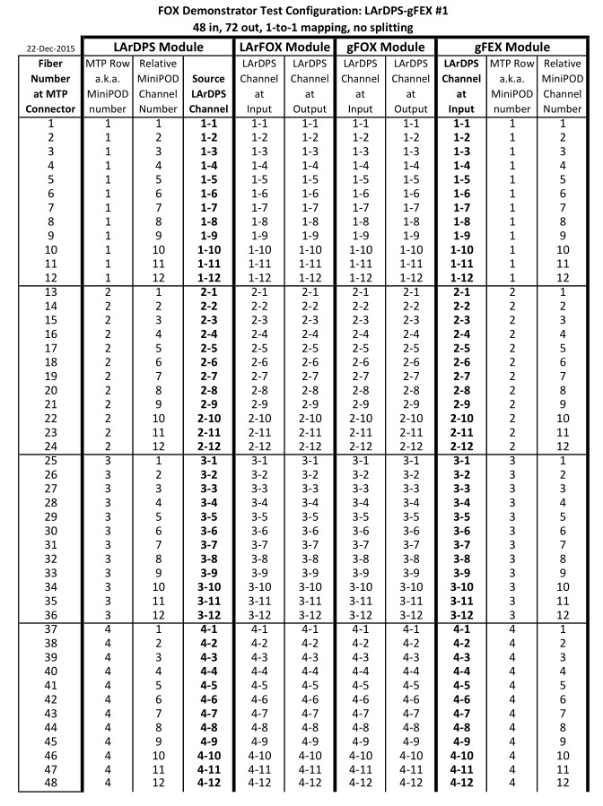
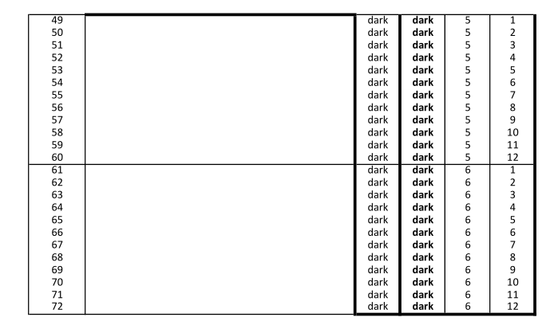
LArDPS to gFEX
Test Configuration
-- without splitters
Detailed connection map between all modules
http://www.pa.msu.edu/hep/atlas/l1calo/fox/specification/2_demonstrator/figures/

Slide 24
LArDPS to gFEX Test Configuration – without splitters: Optical Insertion Loss Measurement with CMX
LC/LC
Trunk Cable (48)
Breakout Cable (48)
Breakout Cable (72)
x48
M
in
M
out
M
in
M
out
(LArFOX)
(gFOX)
MTP
MTP
MTP
MTP
F
F
Trunk Cable (48)
F
F
Trunk Cable (48)
Trunk Cable (72)
F
F
Above the line EXACTLY matches the setup planned for this FOX demonstrator test
MTP
MTP
LC/LC
M
M
12 Fibers
x12
M
MTP
Breakout Cable (48)
out
Breakout Cable (12)
CMX
F
48 Fibers
LC/LC
12 Fibers
x12
M
MTP
in
Breakout Cable (12)
Breakout Cable (72)
F
72 Fibers

Slide 25
LArDPS to gFEX Test Configuration – without splitters:
The same procedure that was illustrated for the measurements
of the LArDPS to eFEX Test Configuration without splitters
is also followed here for :
Offset calibration with CMX
Optical Insertion Loss Measurement with Fluke handheld meter
Offset calibration with Fluke

Slide 26
FOX demonstrator
Configuration for
LArDPS to gFEX Test
-- with splitters

Slide 27
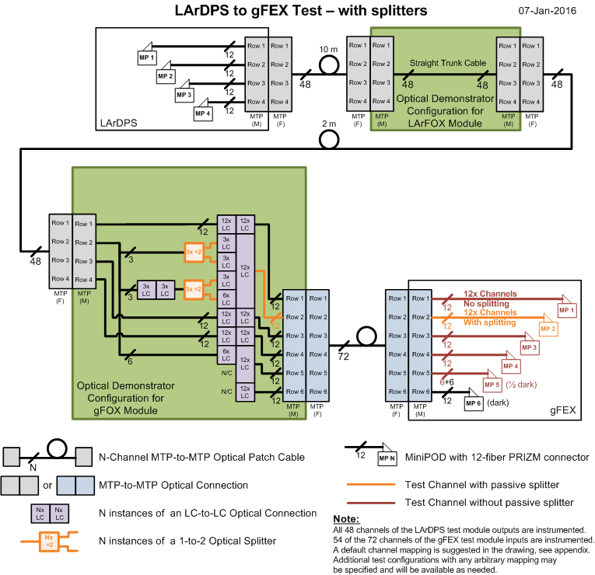
LArDPS to gFEX
Test Configuration
-- with splitters
High level diagram
of LArDPS to gFEX
light paths
http://www.pa.msu.edu/hep/atlas/l1calo/fox/specification/2_demonstrator/figures/

Slide 28
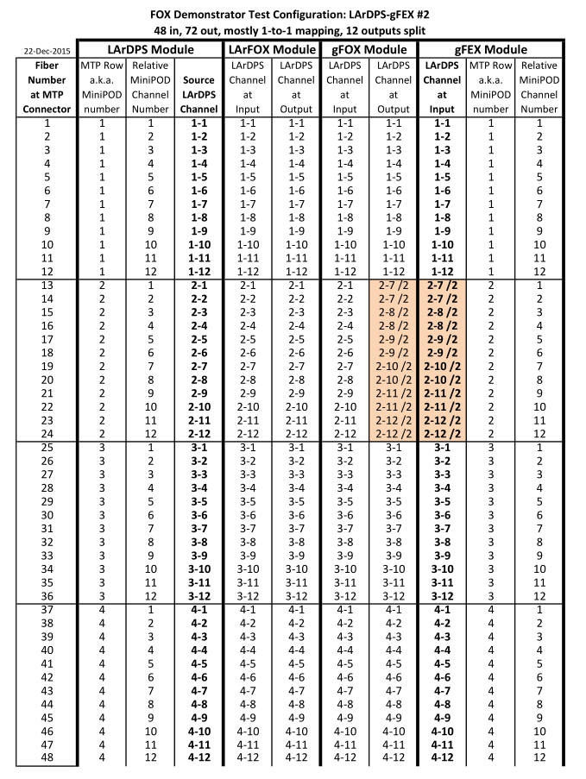
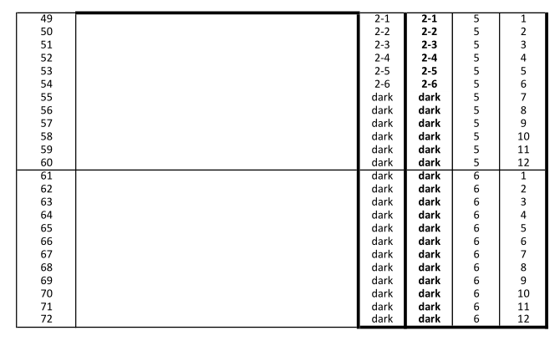
LArDPS to gFEX
Test Configuration
-- with splitters
Detailed connection map between all modules
http://www.pa.msu.edu/hep/atlas/l1calo/fox/specification/2_demonstrator/figures/

Slide 29
LArDPS to gFEX Test Configuration – with splitters: Optical Insertion Loss Measurement with CMX
Breakout Cable (48)
With splittters
LC/LC
Trunk Cable (48)
Breakout Cable (72)
x48
x6
M
in
M
out
M
in
M
out
(LArFOX)
(gFOX)
MTP
MTP
MTP
MTP
F
F
Trunk Cable (48)
F
F
Trunk Cable (48)
Trunk Cable (72)
F
F
Above the line EXACTLY matches the setup planned for this FOX demonstrator test
MTP
MTP
LC/LC
M
M
12 Fibers
x12
M
MTP
Breakout Cable (48)
out
Breakout Cable (12)
CMX
F
48 Fibers
LC/LC
12 Fibers
x12
M
MTP
in
Breakout Cable (12)
Breakout Cable (72)
F
72 Fibers

Slide 30
LArDPS to gFEX Test Configuration – with splitters:
The same procedure that was illustrated for the measurements
of the LArDPS to eFEX Test Configuration without splitters
is also followed here for :
Offset calibration with CMX
Optical Insertion Loss Measurement with Fluke handheld meter
Offset calibration with Fluke

Slide 31
Older Slides

Slide 32
LC/LC
48 Fibers
LC/LC
12 Fibers
48 Fibers
12 Fibers
M
in
M
out
M
in
M
out
F
F
F
F
Trunk Cable
Trunk Cable
F
CMX
Trunk Cable
F
Notes:
CMX(1):
Install in the boxes 12-fiber MALE breakout cables (48-fiber MALE breakout cables).
Connect them to CMX by 12-fiber FEMALE trunks.
Connect 12 fibers by LC/LC couplers to 48-fiber breakout cables inside the boxes.

Slide 33
LC/LC
48 (or 72) Fibers
LC/LC
1 Fiber
48 (or 72) Fibers
1 Fiber
in
M
out
M
in
out
F
F
Trunk Cable
SC
Fluke
Source
LC
Fluke
Meter
Notes:
Fluke (1):
Connect Fluke source/meter by SC/LC test reference cords to the LC connectors in the above setup.
Do measurements for all 48 (or 72) channels.

Slide 34
SC/LC
48 (or 72) Fibers
48 (or 72) Fibers
LC/LC
12 Fibers
12 Fibers
in
M
M
out
M
in
M
out
F
F
F
F
12 Fibers
Trunk Cable
12 Fibers
Fluke
Source
Fluke
Meter
Notes:
Fluke (2):
Do as above for CMX, but instead of 12-fiber FEMALE trunks to CMX install 12-fiber FEMALE breakout cables.
Connect Fluke source/meter by SC/LC test reference cords to the LC connectors in the above setup.
Do measurements for all 48 (or 72) channels.

