Slide 1
P-ONE-1: System Overview and Digitization Update
Rob Halliday and Nathan Whitehorn

Slide 2
System Design Philosophy
We are building the next-generation Optical Module that we really want:
Fast Full Waveform Digitization
Full bandwidth of optical fiber, power savings of copper
Redundancy from having both available
Sub-nanosecond timing synchronization
On-OM data and trigger pre-processing

Slide 3
(Very) High Level Block Diagram
Cable Elements
Copper Timing and Data Transfer Block
PMTs
x16
Data Handling and Processing + Slow Control
(FPGA)
Digitizer
Fiber Data and Timing Board
Power Supply/
DC-DC Conv.
Calibration Devices
Power To All OM Components

Slide 4
Scenario: A DOM Floods
Kraken attacks, DOM floods

Slide 5
Scenario: A DOM Floods
DOM floods
Current spikes at MJB – DOM is cut-off

Slide 6
Scenario: A DOM Floods
Current spikes at MJB – DOM is cut-off
Reconfigure Timing I/Os
Pass Leader token
Resume Operations

Slide 7
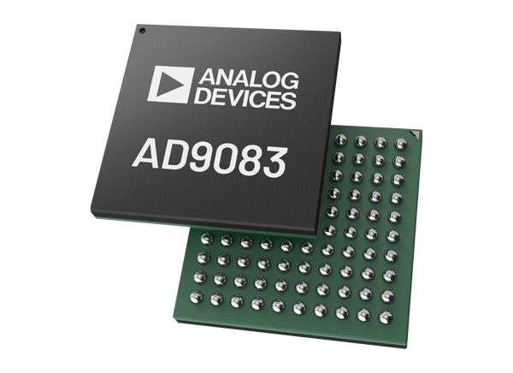
Digitizer
AD9083
Fast ADC meant for low power consumption applications such as cell tower beamforming and “electronic support measures”
16 Channels
12 bit and 16 bit modes
1.2W at our likely settings
<100mw per channel average on all settings
250 Megasamples per second (200MSPS for us)
Built-in front-end filtering
x16

Slide 8
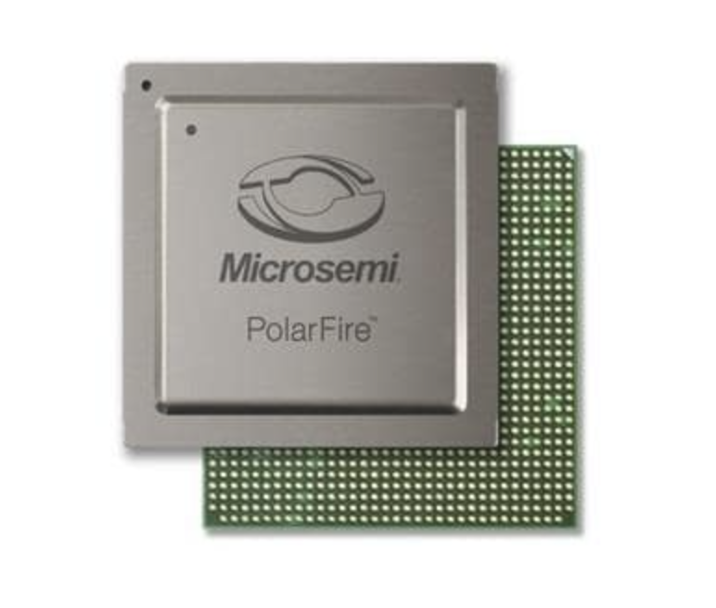
Brains of the operation
PolarFire MPFS250T from Microchip
Low power modern FPGA and Processing System
16 High Speed Data (SerDes, 12.7 Gbps) Lanes
~1.7W Estimated Power Consumption
Plenty of General Purpose Inputs/Outputs for Timing/Data/Calibration
Quad Core Processor for data handling, slow control, etc.

Slide 9
ADIN Switchceiver
(ADIN2111)
SPI
ADC (AD9083)
AD Clock Buffer
(AD4680E)
AD Clock Synchronizers
(AD9546)
JESD204B CLK + Sysref
JESD204B Data
Microchip
FPGA + SoC
(MPFS-250T)
PPS+10MHz
JESD Sysref
P-OM Block Diagram
Timing Interface
Leader Timing/Data Board
Data
Upgoing 10MHz + PPS
Downgoing PPS
Timing Control Switch
10Base-T1L
Power Block
8GB+ DDR4
(2-5s Lookback)
Power To All DOM Components
Fiber From MJB
Power

Slide 10
FPGA + Digitizer
Development Updates

Slide 11
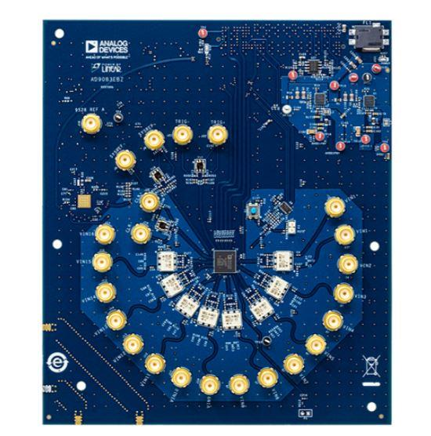
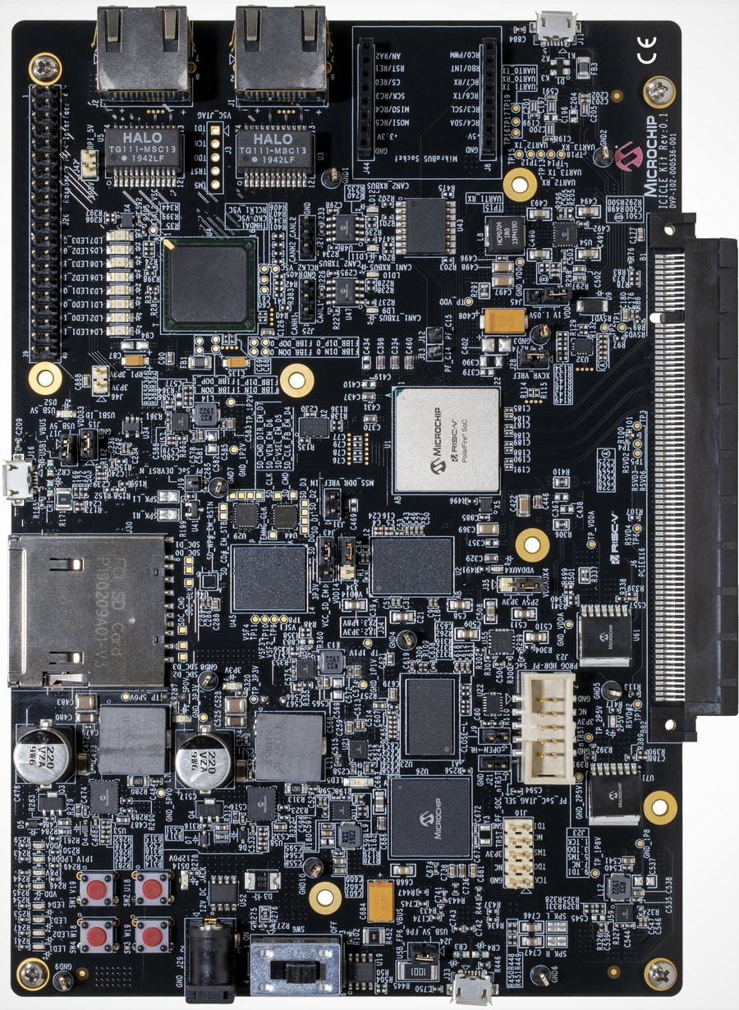
Cast of Characters
Custom Adapter Board
PCIe x16 Connector
FMC connector
Data over JESD204B Link
Slow Control over SPI Link
MPFS-ICICLE board
ADC AD9083 Eval. Board

Slide 12
Basic Steps
FPGA Bitstream
Instantiate Reference Design
Instantiate JESD204B block
Build Bitstream
Adapter Board
Identify needed connections
Build Design in KiCad
Print Prototype Board
Operating Software
Build Reference Linux
Add ADC Drivers
Add write-out abilities, either to SD or network
Build modified Linux

Slide 13
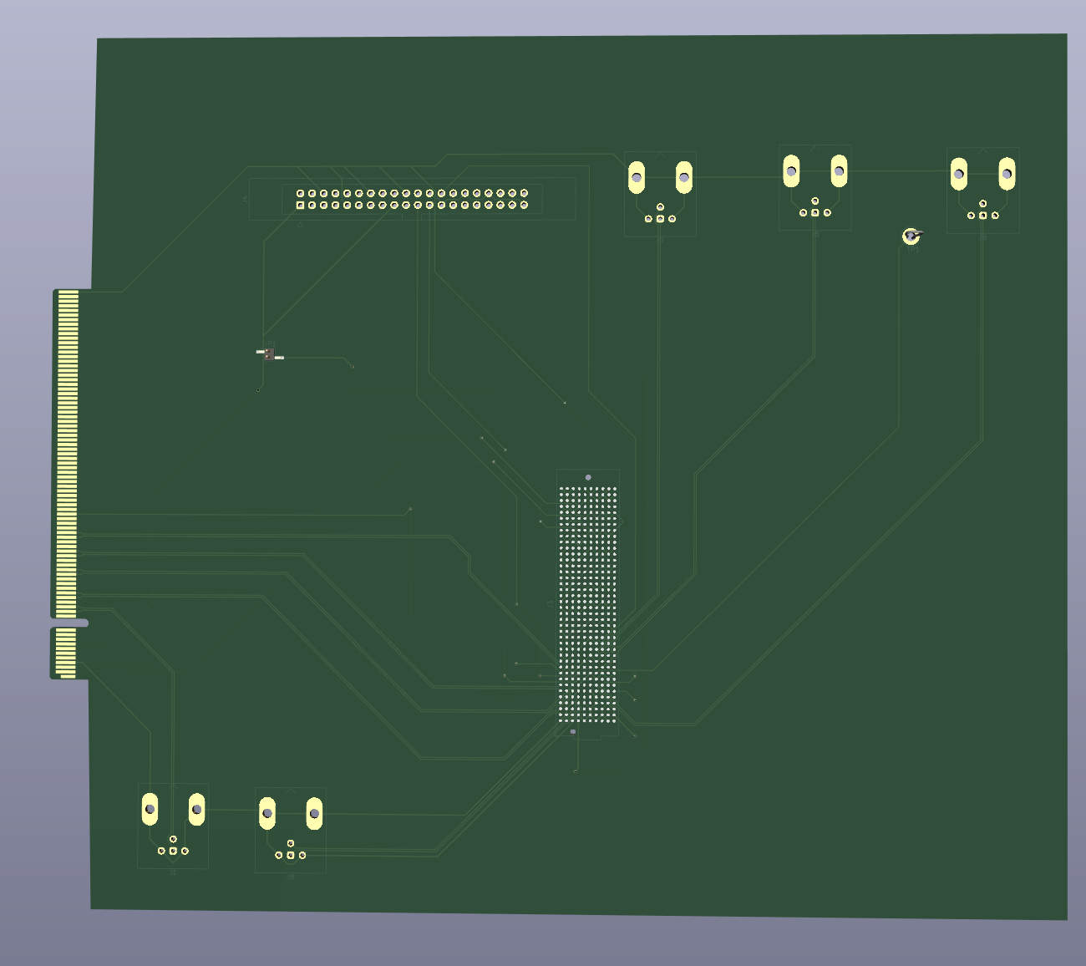
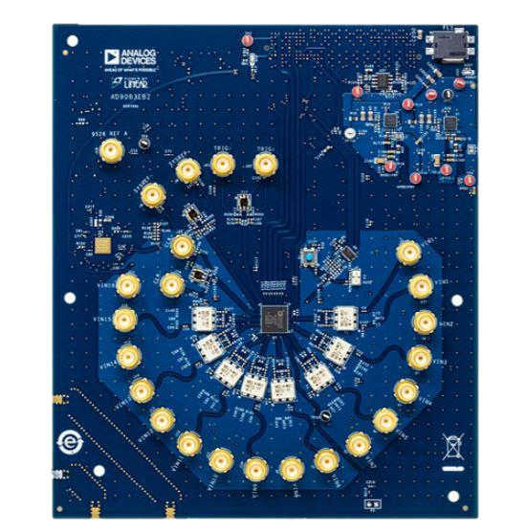
Digitization Adapter Board
MPFS-ICICLE board
ADC AD9083 Eval. Board

Slide 14
Digitization Development Boards
MPFS-ICICLE board
ADC AD9083 Eval. Board

Slide 15
Layout of board
Slow Control
Power Enable Jumper
Timing Outputs
PCI-E connector
SerDes Lanes
ADC Eval Board Seat
Timing Outputs

Slide 16
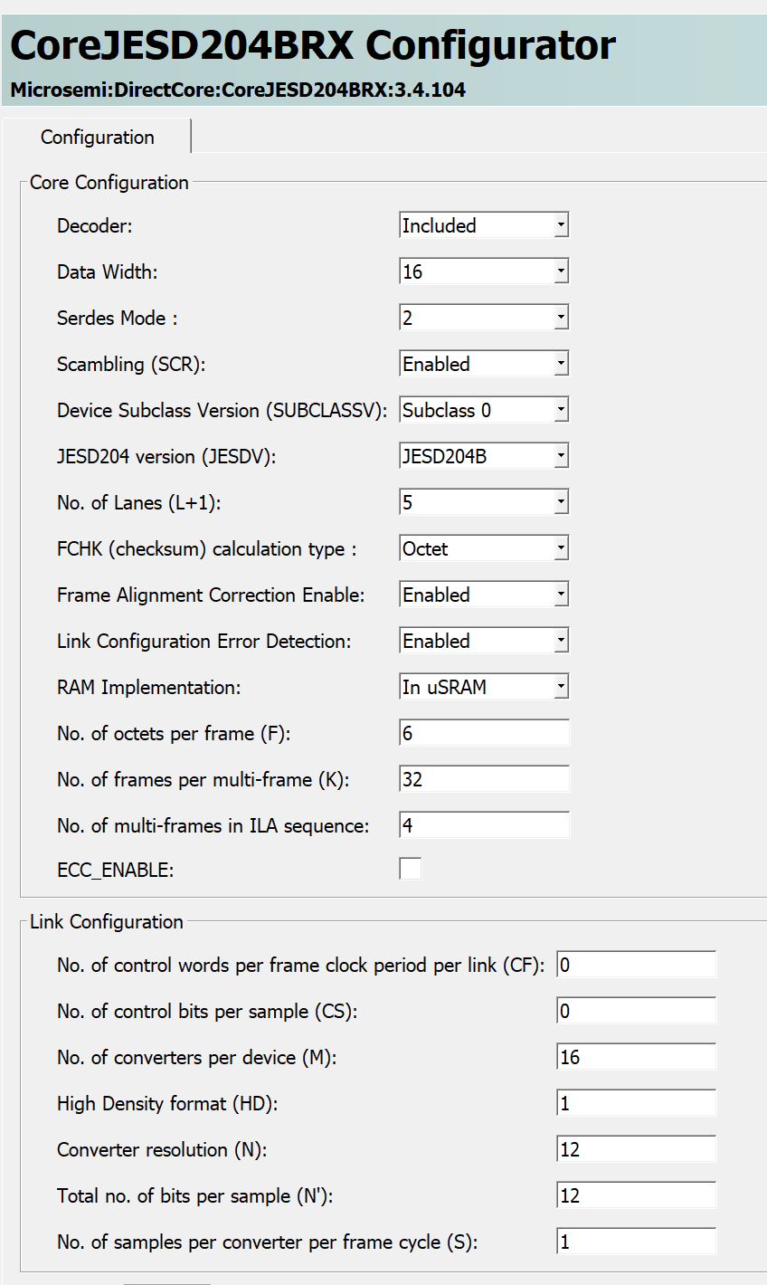
Instantiating JESD204B
Learning new (to me/us) Microchip development environment for FPGA gateware (“Libero”)
Using canned JESD204B core
Once correctly connected, move on to building linux with drivers

Slide 17
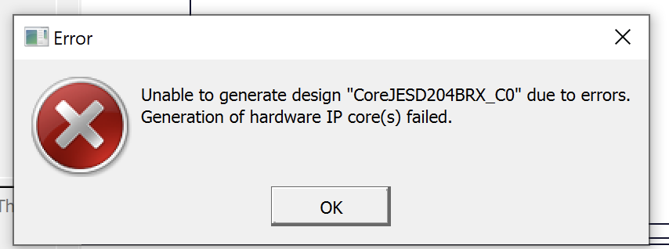
Next step: Buy the (not-cheap) license
Was really hoping we could “try before we buy”
Looks like we will need to buy a license

Slide 18
Conclusions
Digitization Development:
Need to double check and order adapter board
Time to buy the FPGA dev license (or get free!)
Once built:
Record some pulses and determine timing resolution
Measure approximate power usage
Mid future:
Decide on power supply (Michael had suggestion)
Layout prototype board using interface specs
Steady progress continues!

