Slide 1
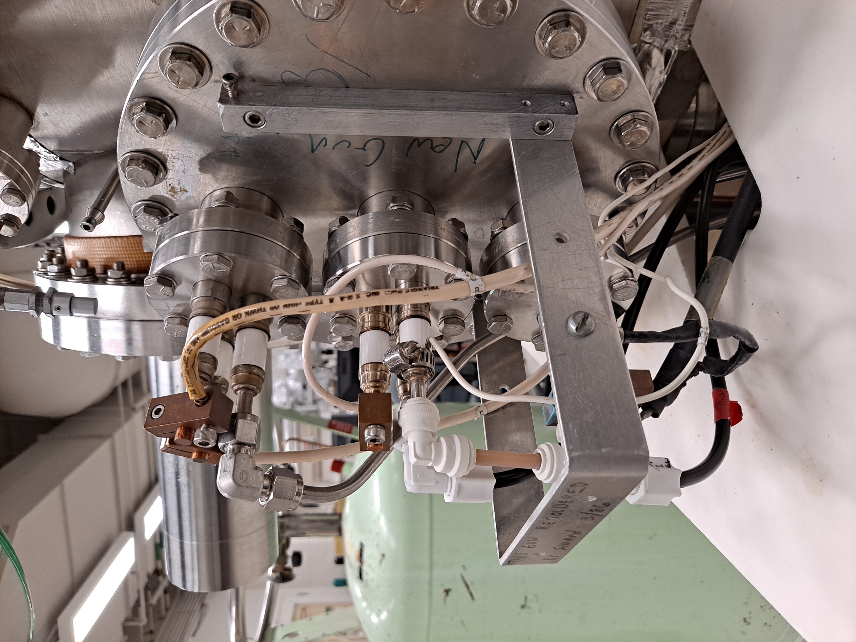
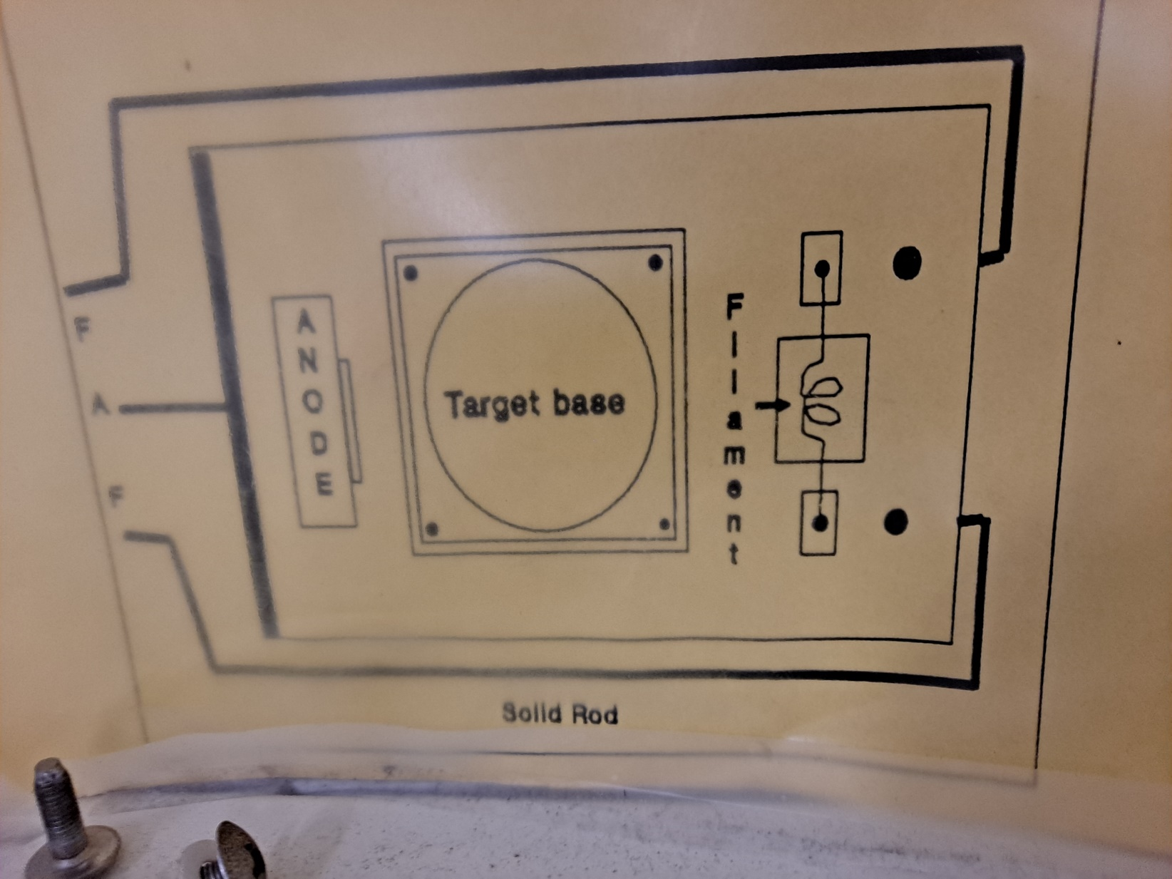
Housing

Slide 2
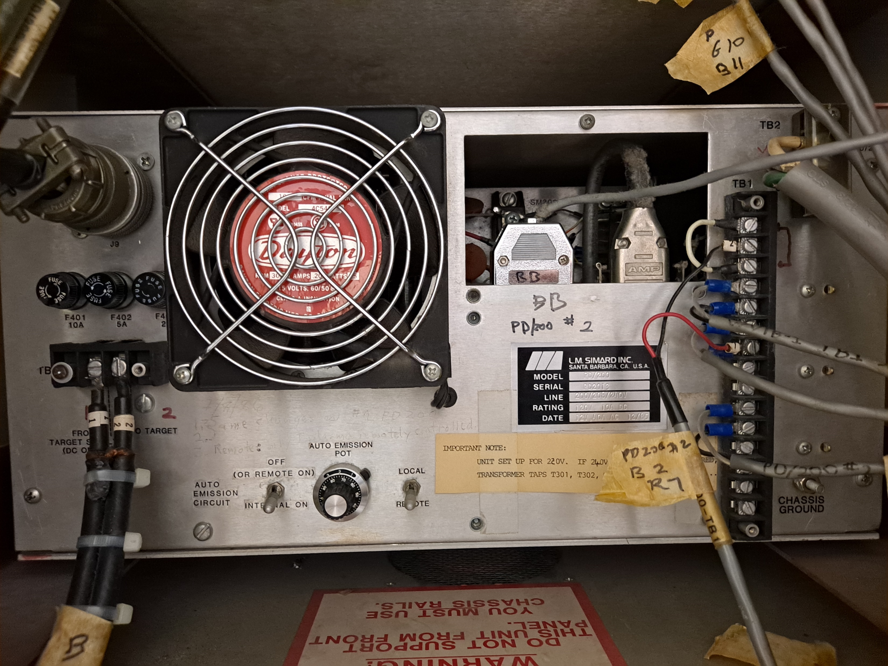
To Filaments and Anode
To Remote box
To interlock box
for water
and Vacuum
2&7 to 2 &1 on TS2
To Target and TS2
10 & 11
To Philips Vacuum gauge

Slide 3
1&2 to 7 & 2 of PD250
To PD250 and
then to Target
3,4,5
And
6,7,8 To Remote box

Slide 4
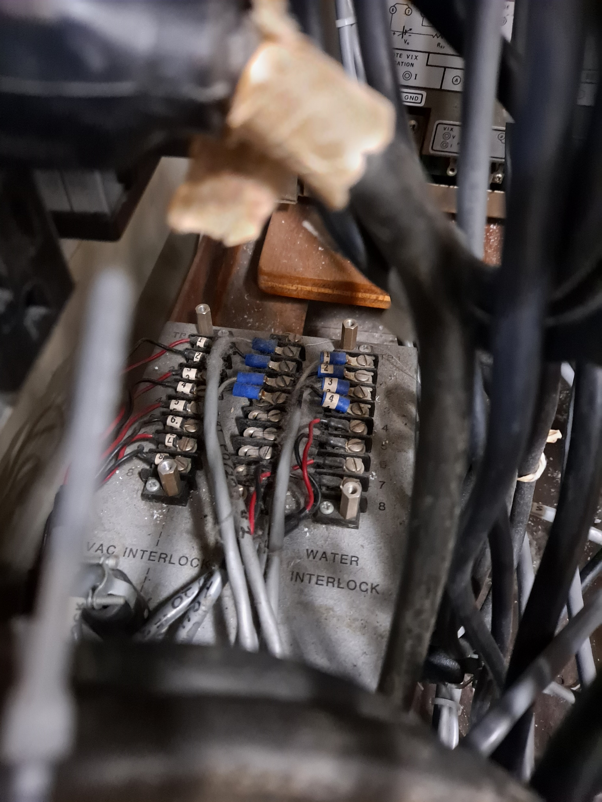
Interlock box
For
Vacuum and Water

Slide 5
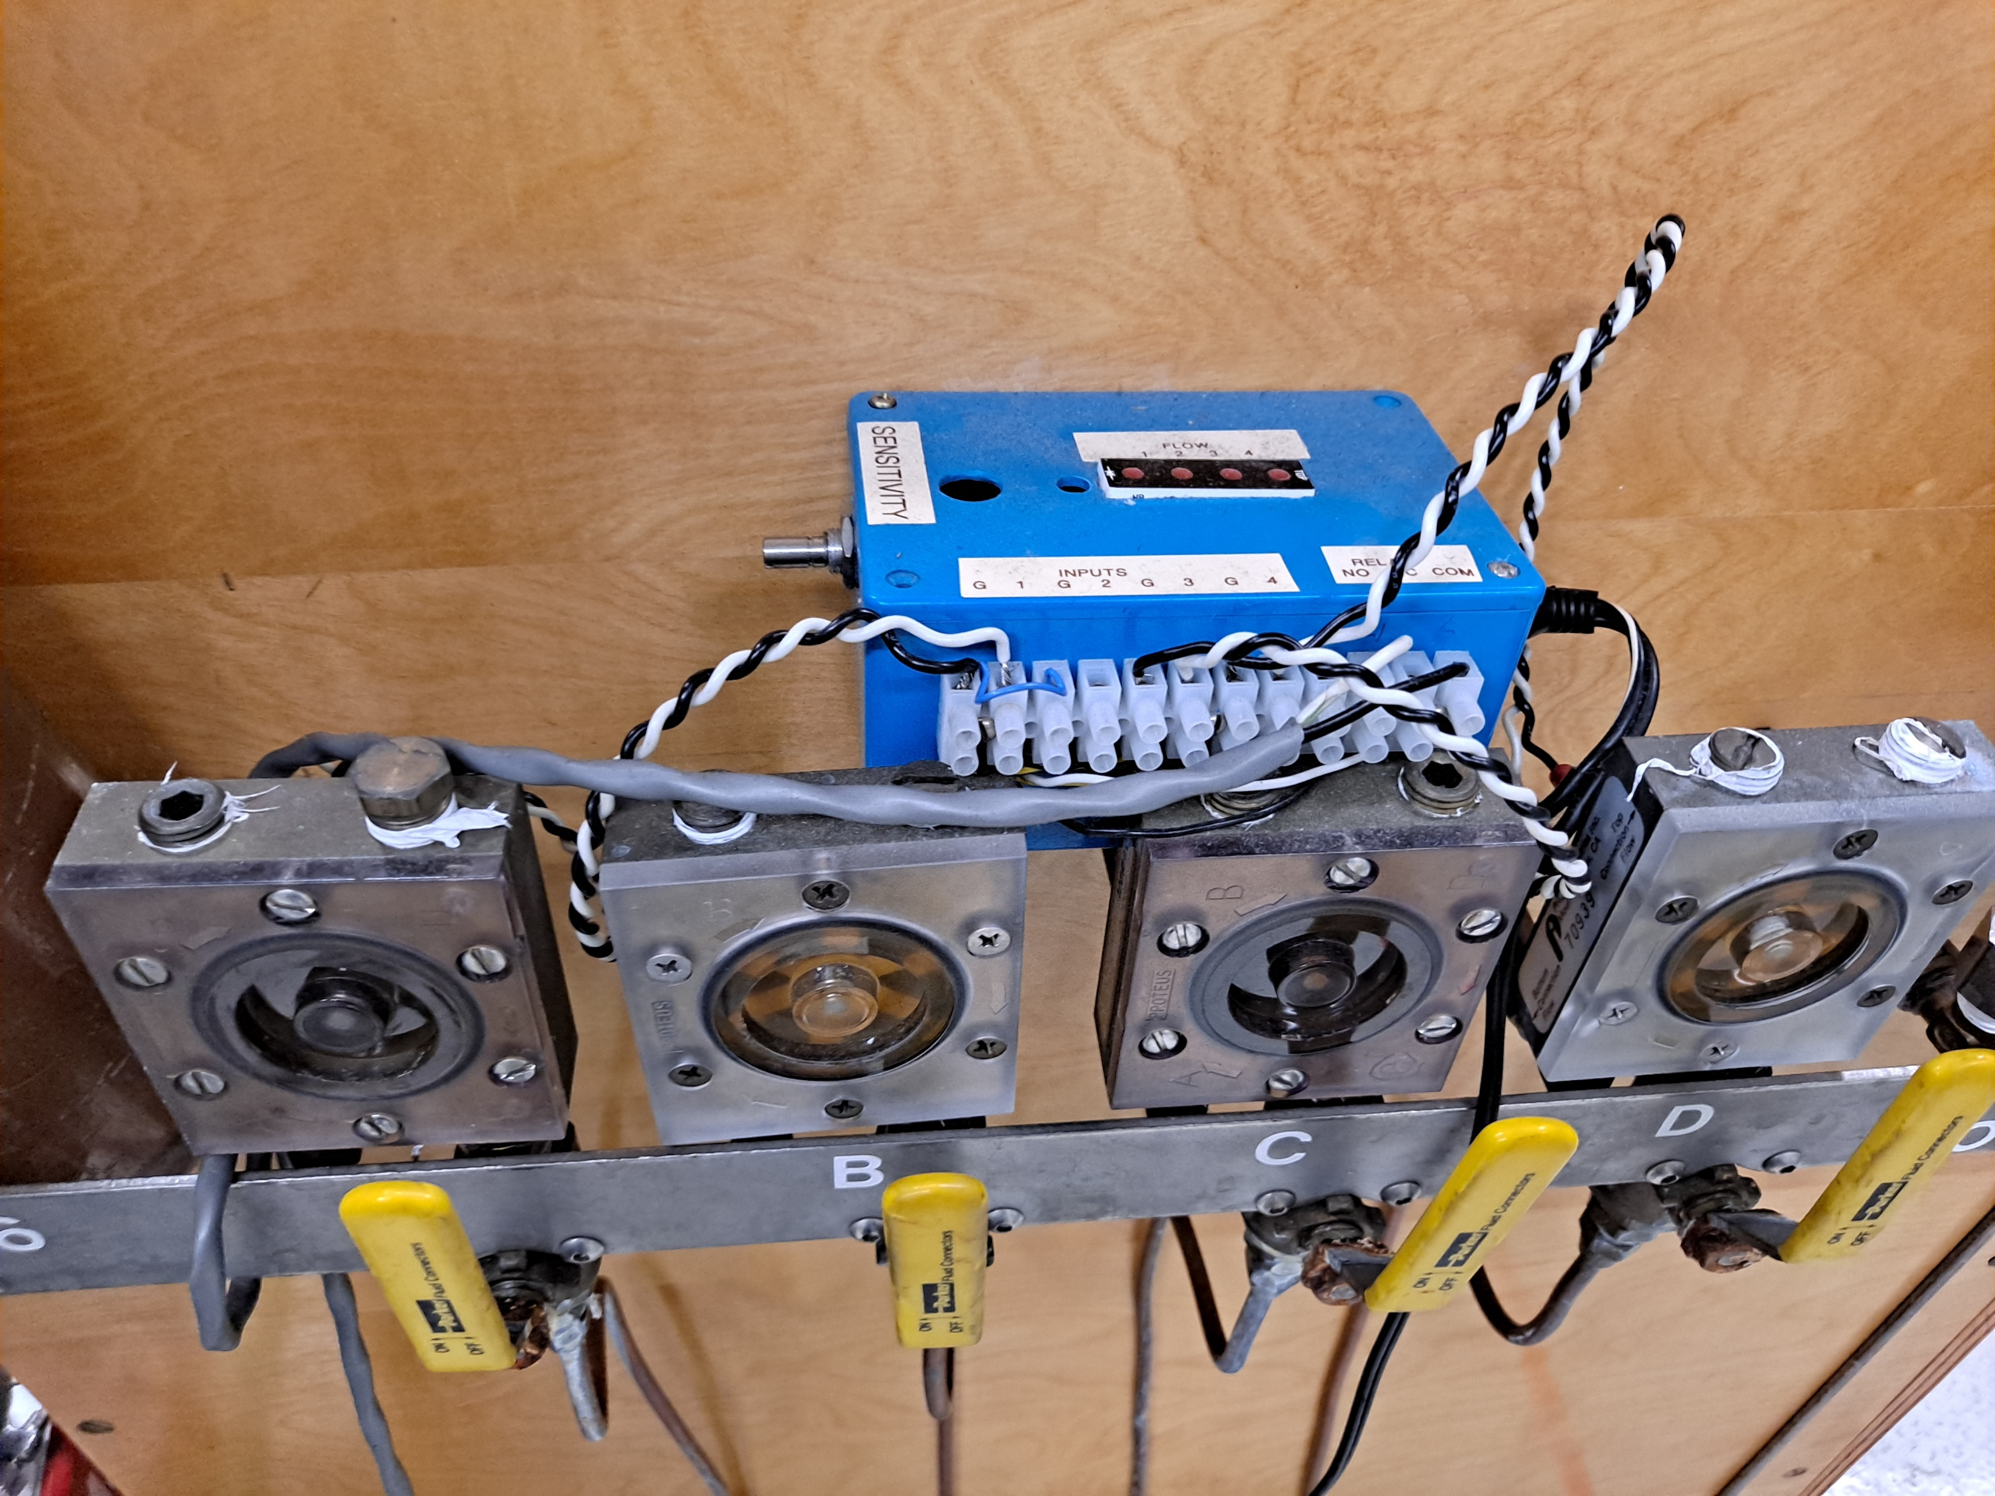
Water interlock to the interlock box

Slide 6
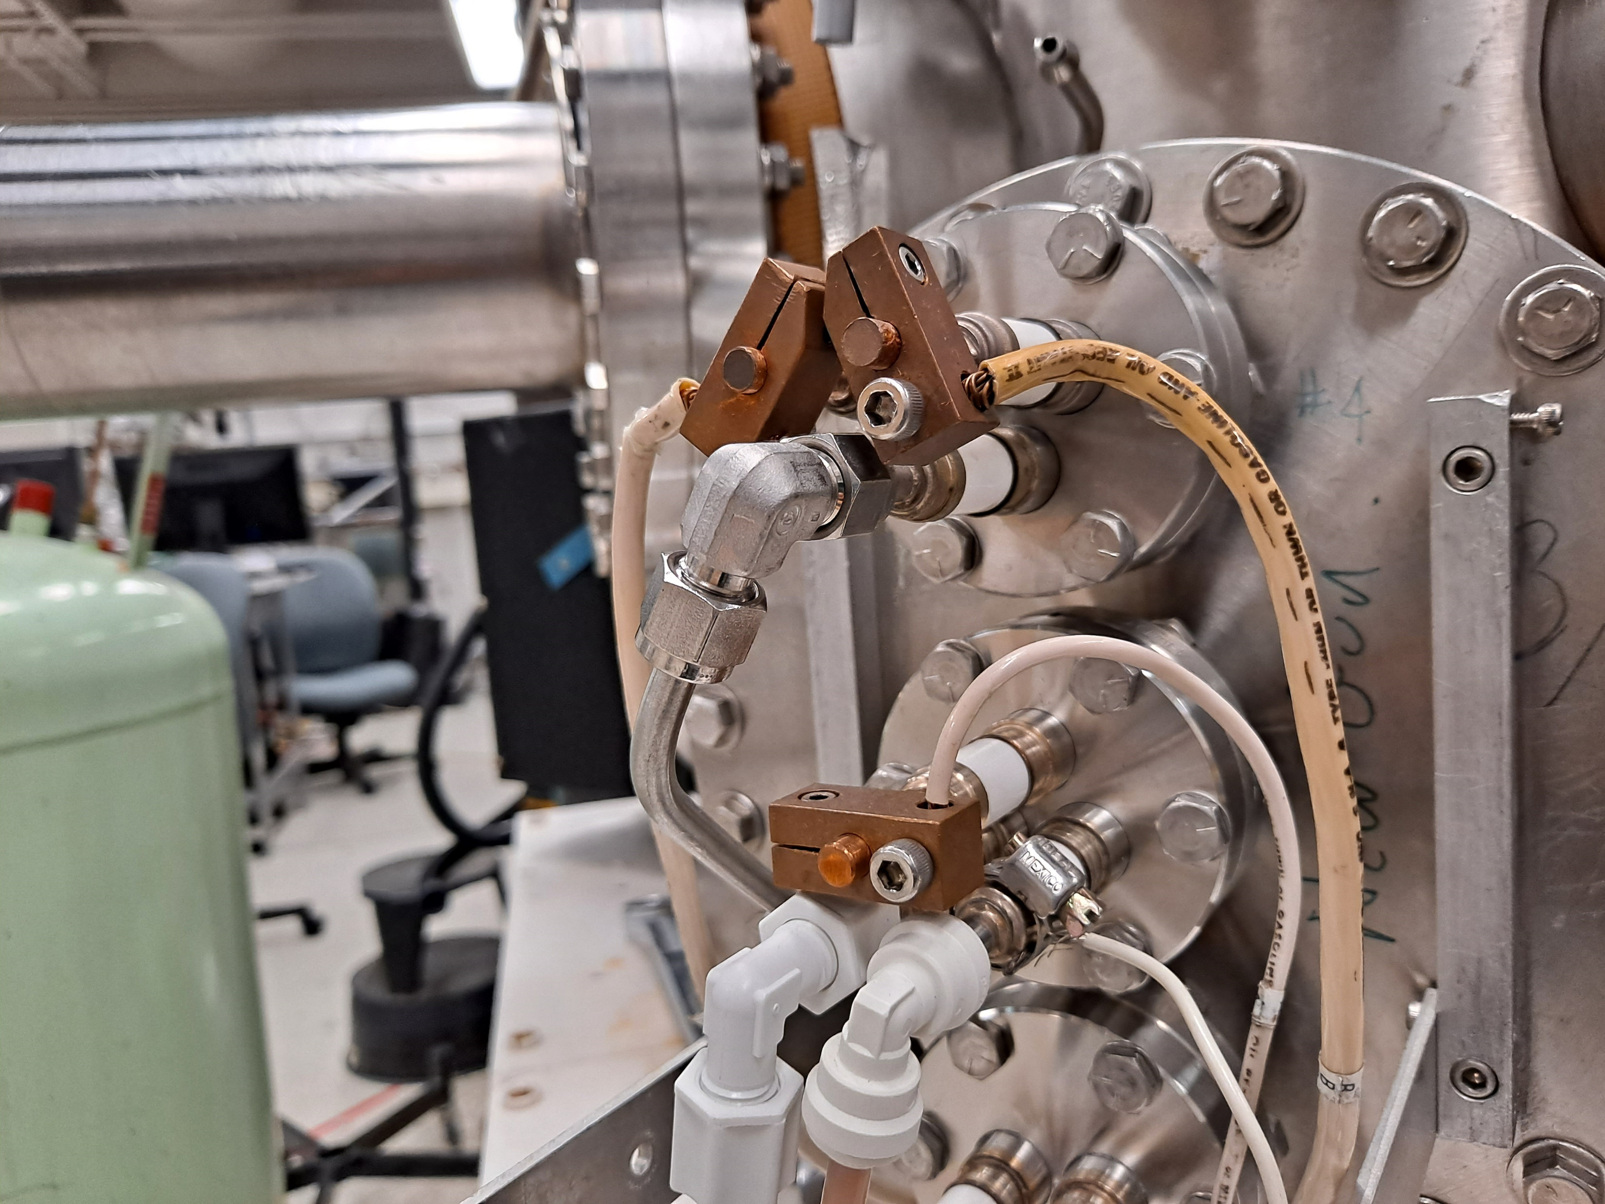

Slide 7
