Slide 1
TTC setup at MSU
6U VME-64 TTC Crate:
TTC clock signal is
Connected to the FELIX Mezz on the
FELIX VC709
Commercial slot 1 CPU
//Currently not involved
in the clock generation
Atlas TTC VX EP 680-1128-300 module
CERN Atlas LTP
EDA-00508 module
CERN-EP TTC vi MKII
EP 680-1128-050-C module
CERN-EP TTC vi MKII
EP 680-1128-050-C module
<number>

Slide 2
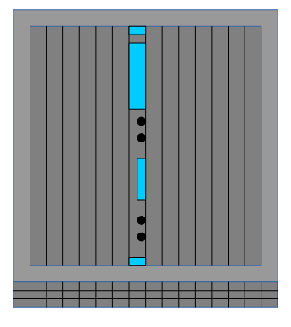
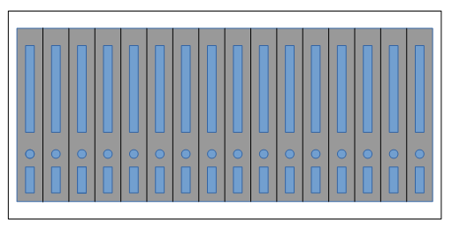
TTC setup at MSU
6U VME-64 TTC Crate:
Classic TTC fiber optic
clock signal comes out
of an ST type fiber optic
connector of the Atlas
TTC VX module and is
connected to the Felix
Mezzanine card
6U VME-64 TTC Crate:
Atlas TTC VX
VC-709
HUB module
FELIX Optical TTC signal comes out of the
type LC connector on an SFP optical module
on the back of the VC-709 board
Felix Mezzanine card on
the Xilinx VC-709 demo board
<number>

Slide 3
TTC setup at MSU
The FELIX Optical TTC signal comes out of the type LC connector on an SFP optical module on the back of the VC-709
An LC type fiber optical cable a few meters long runs from the VC-709 SFP optical
module to a short MPO to LC fiber optic breakout cable. The MPO connector on this
breakout cable runs to a short MPO to PRIZM connector cable that plugs into the
Receiver MiniPOD on the HUB module
Once on the HUB module the FELIX Optical TTC signal is converted into an electrical
signal by the MiniPOD Receiver and then its electrical signal is connected via circuit board traces to an MGT Receiver on the HUB’s FPGA
We monitor the clock output from these VME clock Modules via the Clock Output ECL
LEMO connector near the middle of the Atlas TTC VX module
<number>

Slide 4
Combined_TTC/DATA overview
HUB module is obliged to distribute TTC information throughout the shelf.
The combined_TTC/DATA bits are defined to provide TTC information as well
as initialization functions (Aurora).The link is set to run at 6.4Gbps raw rate
The HUB uses MiniPOD optical receiver to receive TTC signals from the FELIX system
Receive the Reset signal (Aurora Initialization) from the Readout_CTRL stream and
distribute it to the appropriate shelf slot
Several Combined_TTC links within the shelf; each FEX slot (3-14); one between
each HUB and ROD; links between two HUBs
Combined_TTC/DATA links on the HUB FPGA is implemented with use of several
components, including the MGT transceivers (GTH and GTY), control and diagnostic logic
<number>

Slide 5
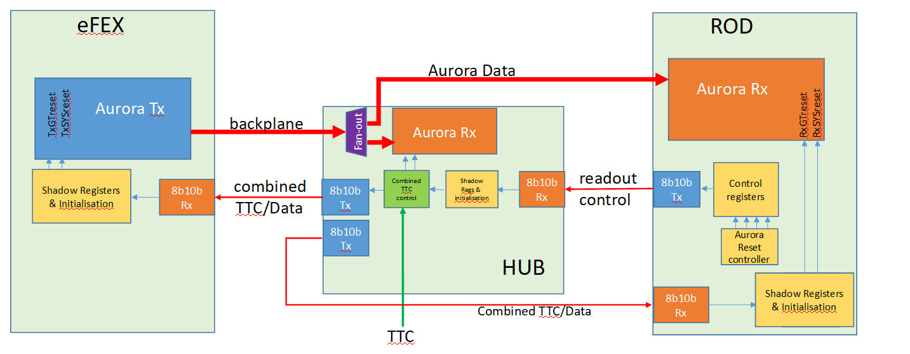
Combined_TTC/DATA overview
Full spec at: Specification for Readout Control & Combined TTC Serial links in L1Calo
<number>

Slide 6
Combined_TTC/DATA
Bit definition
The bits within the Combined_TTC/DATA control words are primarily defined to provide TTC
information as well as initialization functions for all of the Fex data links (Aurora in the case of eFex).
The TTC information is sourced from a dedicated TTC interface on the Hub. The Reset information is
received from the ROD via the Readout_Ctrl link.
Comma Character
#Bits 7 to 0 of Word_0 contain the Comma character that maintains alignment of the 4 shadow registers with their corresponding Control registers. The chosen character is K28.5 = 0xBC.
Version
#The 4-bit value contains the version number of this overall bit assignment. It will be held at “0000”
through the initial debug phases, where many changes may occur.
Reset 3:0
#These bits provide a system level reset/enable function. There are four per slot, and the functionality of these bits will be specified by the targets (eFex, jFex, etc).
Level-1 Accept (L1A)
#L1 Accept is used to indicate when an event has been accepted by the Central Trigger Processor.
<number>

Slide 7
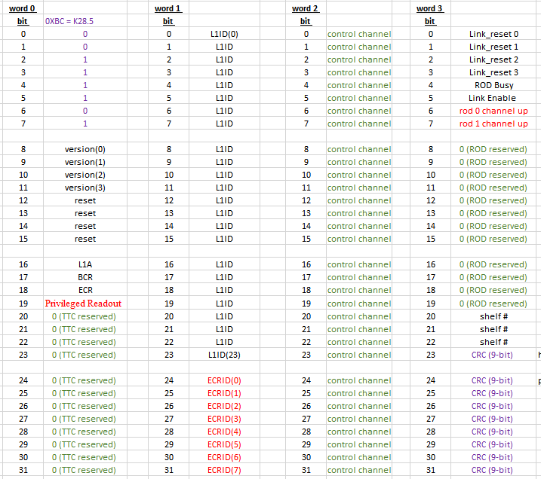
Combined_TTC/DATA
Bit definition
Combined_TTC/DATA bit definitions:
The least significant byte of Word_0 is reserved for the 8b10b Comma
Character K28.5
<number>

Slide 8
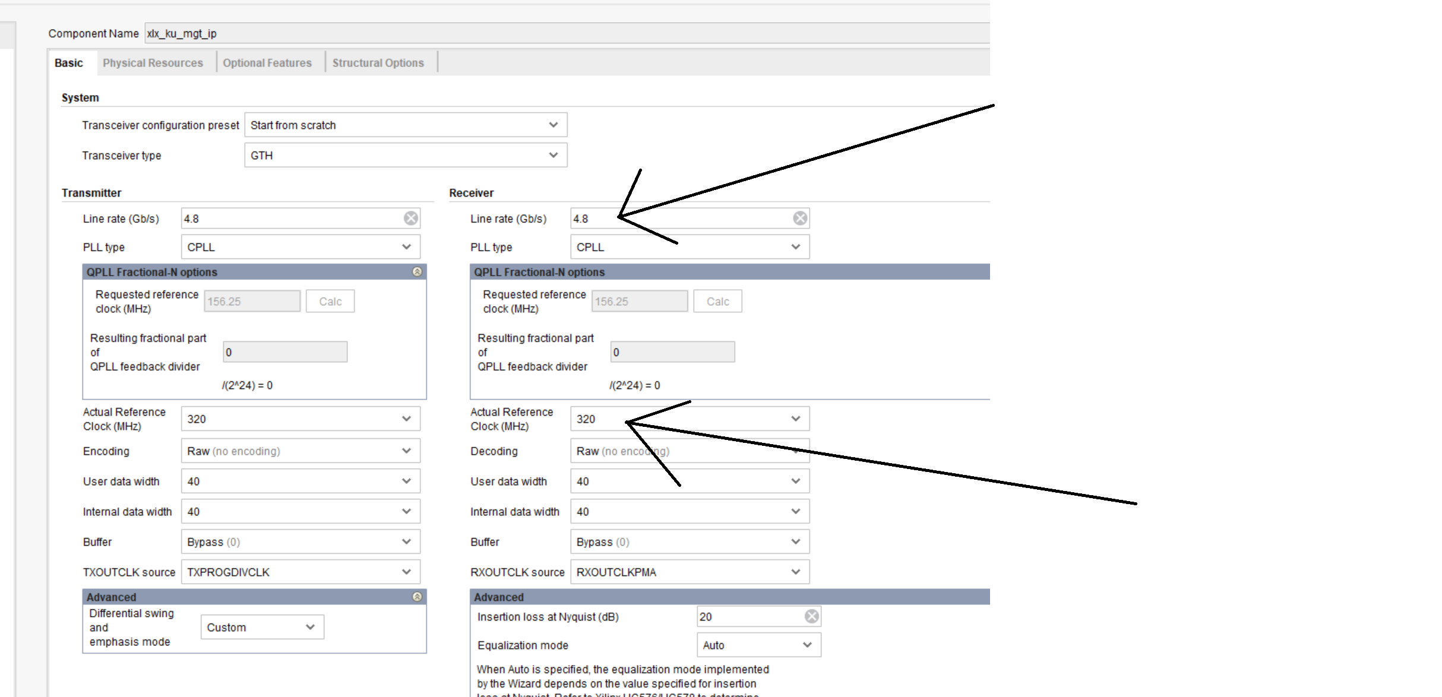
HUB: GBT protocol study
MGT Configuration:
<number>

Slide 9
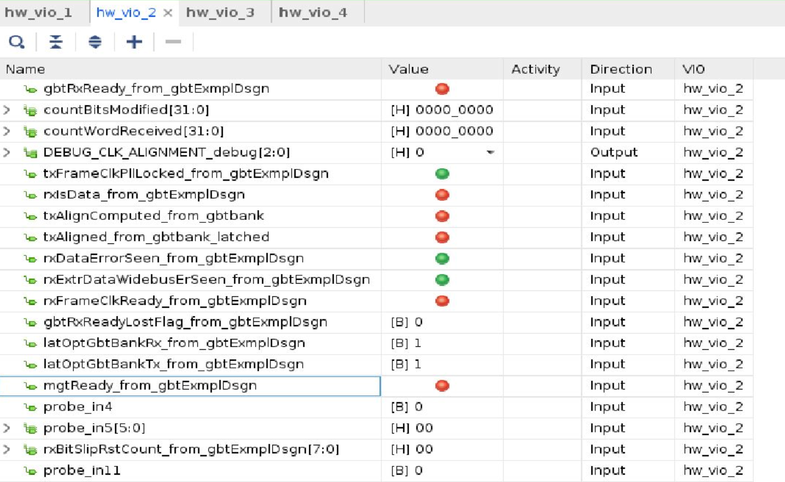
HUB: GBT protocol study
GBT/MGT status if the reset is hold:
<number>

Slide 10
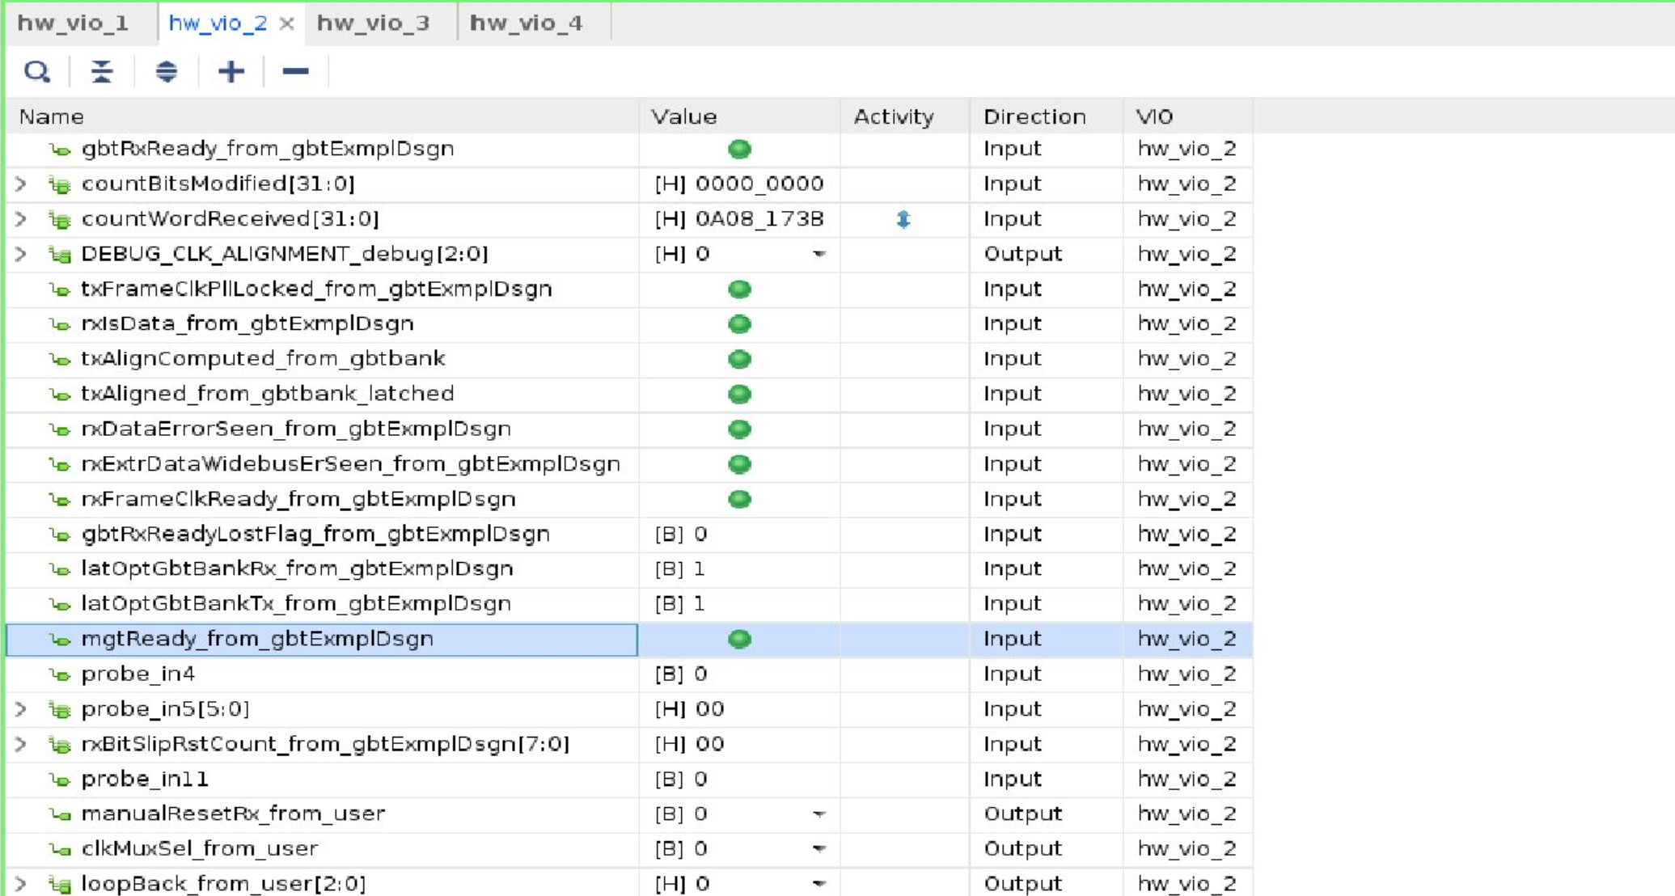
HUB: GBT protocol study
GBT/MGT status if the reset is released:
<number>

Slide 11
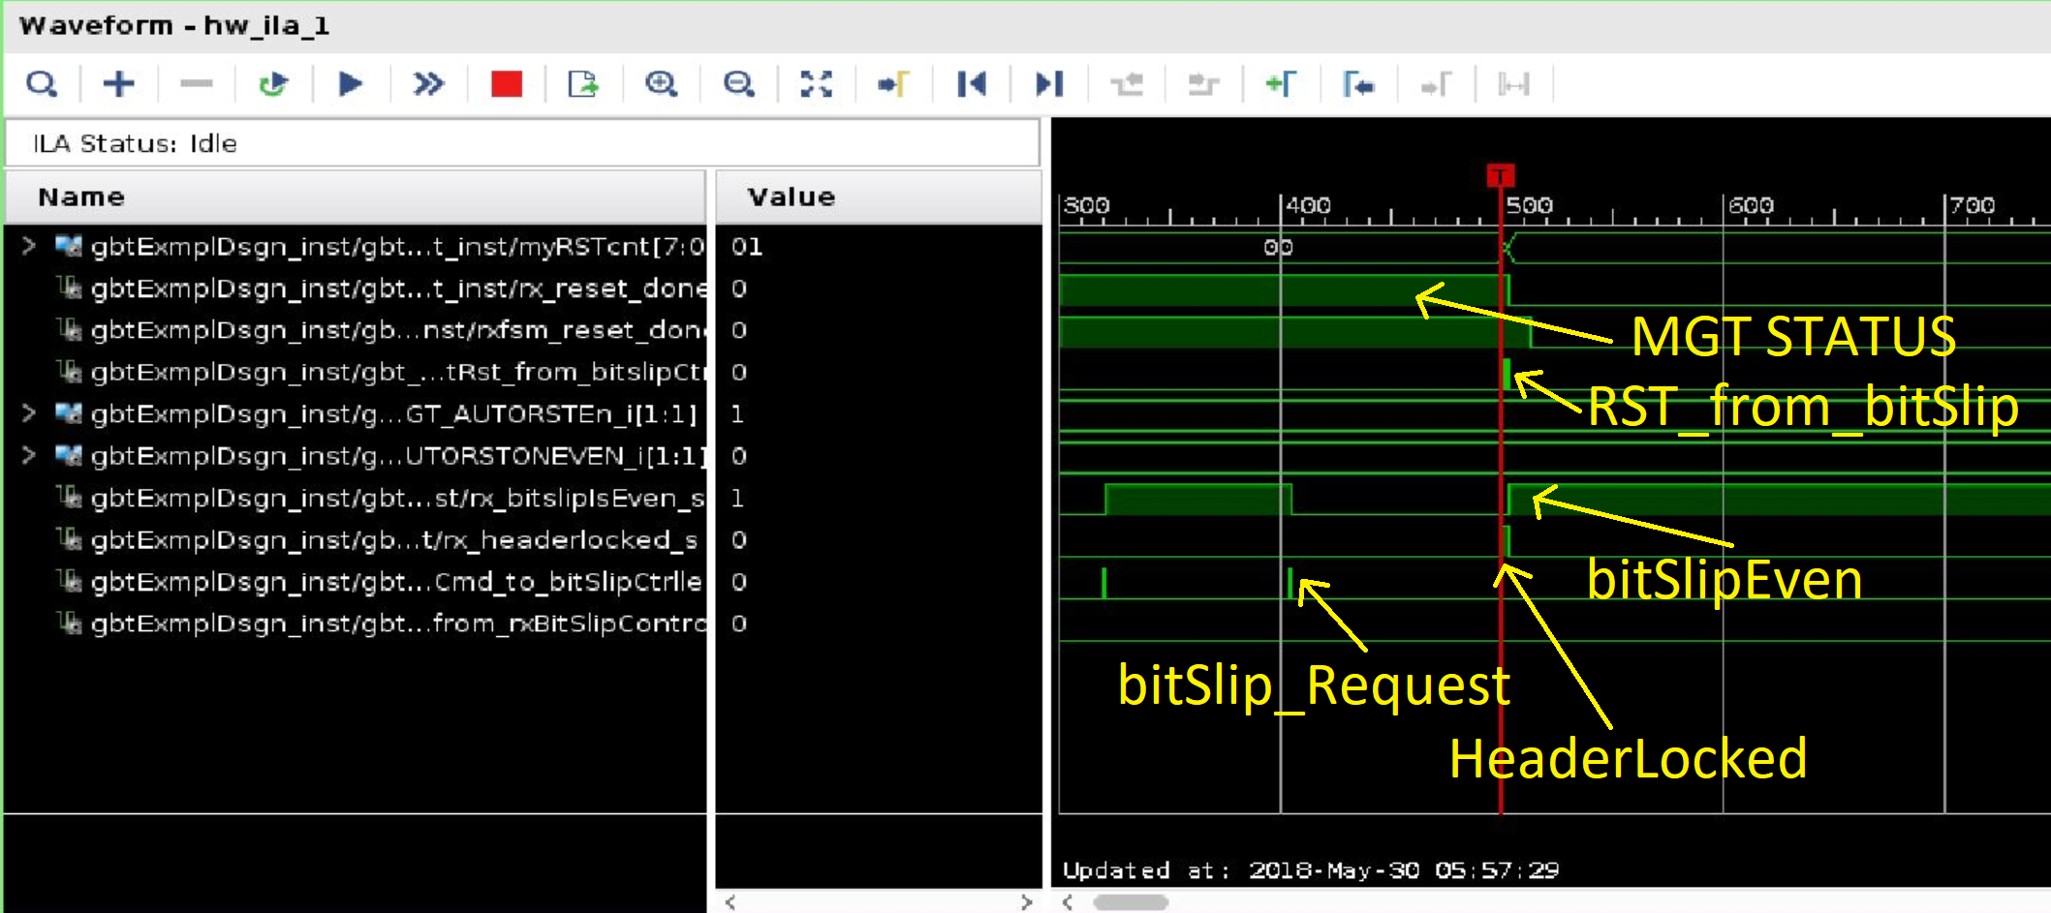
HUB: GBT protocol study
GBT startup, part 1:
The MGT status OK. Th bitSlipEven, *must* be *odd*.
But, in this case is *even*, that's why the MGT RST is issued.
The GBT startup procedure will be repeated.
<number>

Slide 12
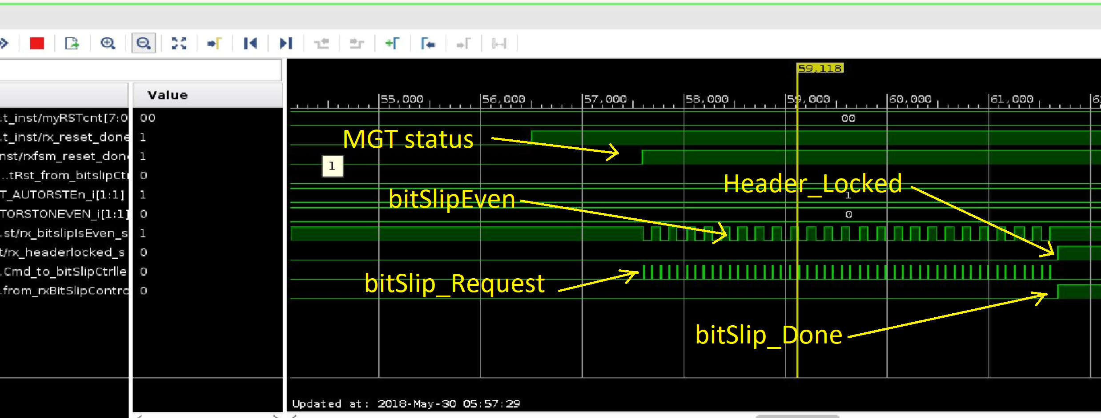
HUB: GBT protocol study
GBT startup, part 2:
The MGT status OK. The bitSlipEven, must be *odd*.
Yes, in this case is *odd*. The GBT startup is completed
<number>

Slide 13
HUB: GBT protocol study
GBT RX data:
The GBT RX data captured with the use of ILA.
<number>

Slide 14
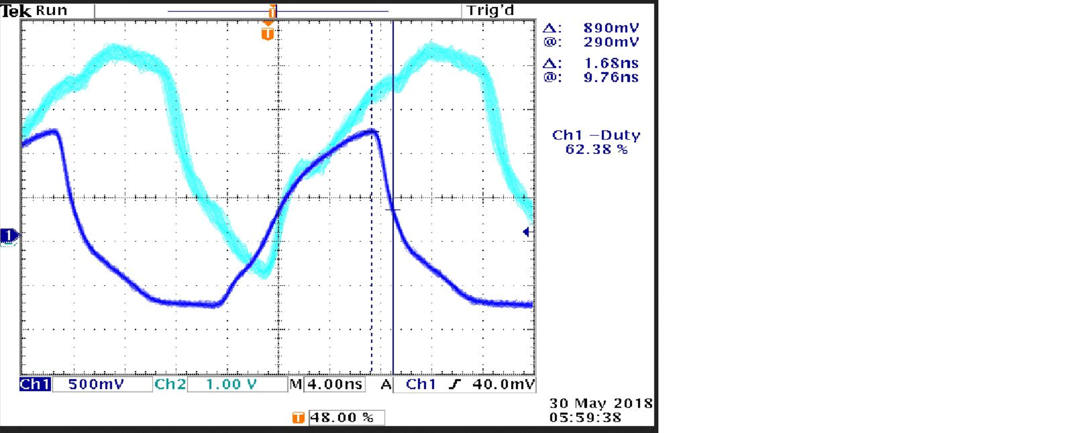
HUB: GBT protocol study
RxFrameClk_from_gbtExampleDesign:
We monitor the RxFrameClk_from_gbtExampleDesign on the scope:
Ch 1 on the scope comes from the VME modules that provide the 40.08 MHz TTC reference Clk to the VC709 Felix source. This reference Clk signal is always running on the scope. Ch 2 on the scope comes from the Access Signal output from the Hub Module (RxFrameClk_from_gbtExampleDesign). When the Ch 2 signal is ON it is stable and locked to the reference Clk that comes from the VME modules.
<number>

Slide 15
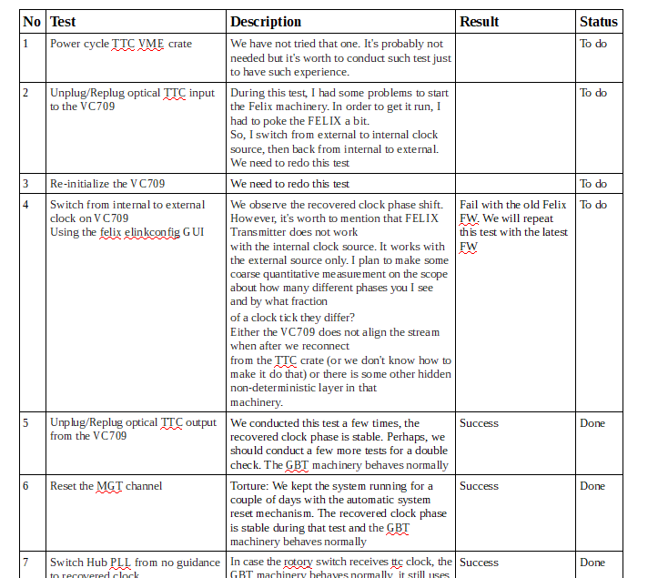
HUB: GBT protocol study
Test disruptions and verification for restoring - or not – a deterministic 40.08MHz recovered clock phase.
<number>

Slide 16
Quick summary
TTC setup at MSU works; GBT protocol implemented on HUB FPGA, various tests ongoing
TTC decoder will be tested soon (Kuan and Pawel)
TTC simulator on the HUB might be implemented to perform the urgent tests
<number>

